Slide 1
Lessons learnt from having to adapt to the Covid pandemic in Higher Education
ED WORKS: Centre for Education Talk
Dr Anna Battaglia
Centre for Education
King’s College London
Faculty of Life Science & Medicine

Slide 2
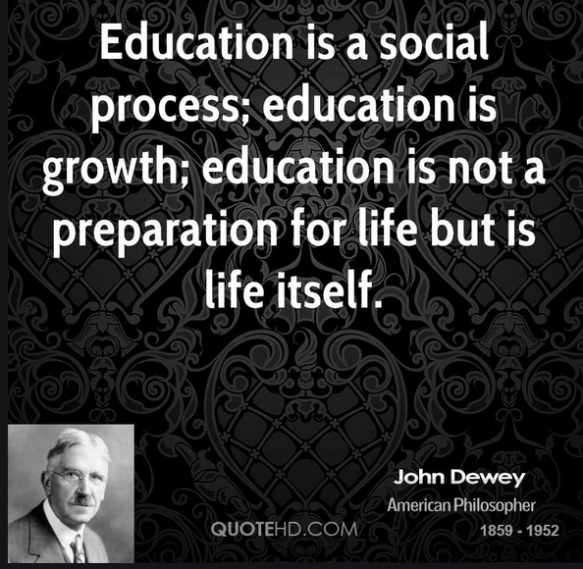
ABSTRACT
”The lesson is not a journey on a tram that drags you inexorably
on fixed tracks and takes you to the destination by the shortest way,
but it is a walk, a trip, albeit with an end point, the goal,
without having, however, a single need, a single purpose:
to reach the goal ". Pavel Florenskij, 1917 (a great permafrost scientist
and teacher, killed by Stalin in 1937 for helping students to think)

Slide 3
I would like to discuss with colleagues about the impact that the Covid-19 pandemic has had on our students (e.g., from an educational perspective and from a well-being one). Many aspects of what HE used to be, have been forcefully changed under the pressure of the current pandemic. Institutions were diversely ready for changing the way their students were taught and assessed. The perception is that there is no going back. The talk/discussion will be around lessons learnt, what can be kept and what we can get rid of.

Slide 4
Points of discussion
The lecturer’s role
How to foster a sense of community and belonging
How to assess post-Covid
How to improve mental wellbeing

Slide 5
Teaching as a social activity
I believe with Plato, Socrates, and more recently John Dewey, that teaching is a social activity and the new ways of teaching have often challenged this basic tenet of pedagogy.

Slide 6
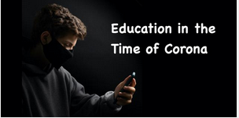
Teaching as a social activity
The idea of universities as places where sociality is as important as the subject knowledge, can vanish if we are not careful (see right panel).
The ‘lesson’ is a social event, knowledge comes from questioning not from teaching (do you remember Plato, Socrates?).."from ancient times to modern times, from Plato to Dewey, the notion is this:
“effective pedagogy involves dialogue, involves conversation, and by definition dialogue and conversation are social activities. Learning is a social process (C Norris & E Soloway).”
The risk of distance ‘learning’: the belief that as subject material can be downloaded this is sufficient for learning..a conception of knowledge as something which can be transferred through videos, recordings into the head of someone else anytime one wants.
Philosopher Yuval Harari bemoaned the loss of interaction between students taking classes on Zoom. “When I went to university,” he reminisced, “the most interesting and important things happened in the breaks [between lectures].”

Slide 7
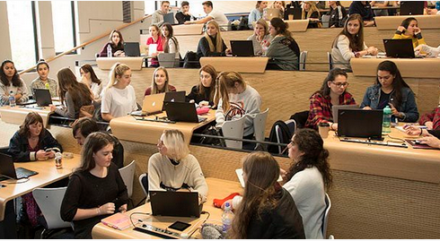
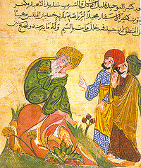
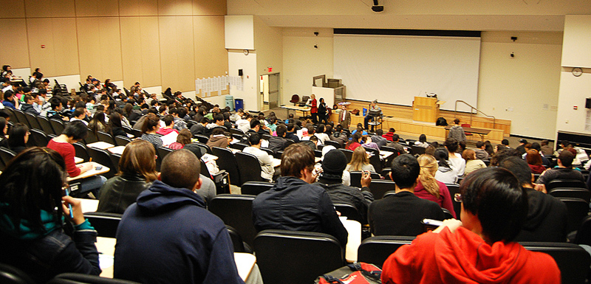
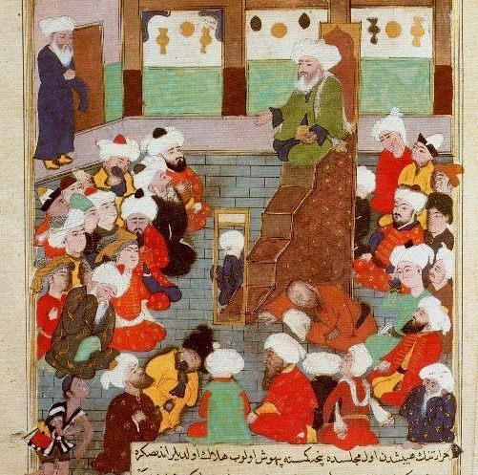

Slide 9
The lecturer’s role
The lecture was ailing before Covid
Lecture theatres are on the way out
BUT
Is the recorded online lecture the alternative? Simply uploading online what was previously delivered face-to-face?
Can we think of alternative methods? (see next slide)
e.g., “panel discussions, animated explanations, online experimentation, problem solving demonstration videos, etc.,”
AND
What is the lecturer’s role in the post Covid era? How can we reconceptualize the ‘sage on stage’ persona?
https://theconversation.com/covid-killed-the-on-campus-lecture-but-will-unis-raise-it-from-the-dead-152971

Slide 10
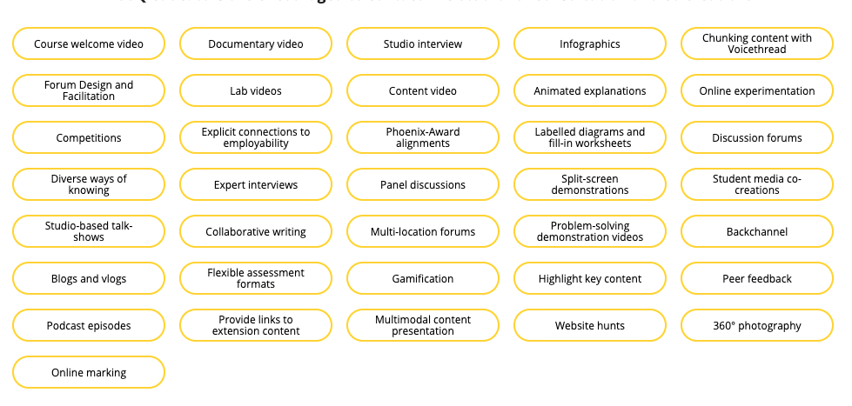
https://digitalfirst.usq.edu.au/#!#page-teaching-approaches

Slide 11
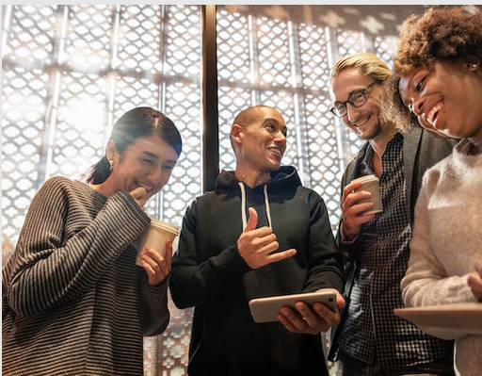
How to foster a sense of community and belonging in HE post-Covid

Slide 12
What defines a community of learners?
Many scholars and practitioners agree that learning communities “set the ambience for life-giving and uplifting experiences necessary to advance an individual and a whole society” (Lenning and Ebbers, 1999). Because learning communities are so important to student learning and satisfaction, clear definitions that enable sharing of best practices are essential. By clarifying our understanding and expectations about what we hope students will be able to do, learn, and become in a learning community, we can more precisely identify what our ideal learning community would be like and distinguish this ideal from the less effective/efficient communities existing in everyday life and learning.”
West, R. E. & Williams, G. (2018). I don’t think that word means what you think it means: A proposed framework for defining learning communities. Educational Technology Research and Development
The defining characteristics of learning communities,
representing different ways of defining the boundaries of a
community. From West & Williams, 2018

Slide 13
How to foster a real social environment online conducive to motivation and learning
Authenticity matters, so when an instructor is perceived as a real person who engages with their students and creates a personal connection, students are more likely to learn and enjoy what they are learning” (Anderson, Rourke, Garrison & Archer, 2001).
Human connection is as important today as it was long ago.
Online environments make social connections even more important as instructors do not have the opportunity to meet with their students face to face in a classroom. Online students often feel isolated, which may decrease motivation and increase attrition. When learning occurs entirely through computer-mediated instruction, an important part of the instructor’s role is ensuring the learning environment is “people focused” or humanized (Dupin-Bryant, 2005)
Peer learning can be particularly useful when it comes to using online tools. “Whereas “pedagogy” has to do with “the transmission of knowledge from teachers to students, peeragogy describes the way peers produce and utilize knowledge together” (Rheingold et al., 2015, p. 9)
The social learning view sees the ‘student as producer’ educational model, which contrasts with the usual view of ‘students as consumers of knowledge’. According to Neary (2014, p1), the student as producer approach emphasizes “the role of students as collaborators with academics in the production and representation of knowledge and meaning”. In so doing, it “aims to radically democratize the process of knowledge production” (Neary and Winn, 2009, p. 201).

Slide 14
This is how we have created a community of learners during the pandemic: Perspectives on Pain and Nervous System Disorders with the invaluable collaboration of Dr Isabella Gavazzi, IoPPN 2020-2021 10th Year Anniversary!

Slide 15
Peer feedback

Slide 16
Lessons learnt
Embed students’ interactions in whatever session you are delivering to build a community of knowledge rather than multiple islands of loneliness
Make them work together to prepare for debating sessions, or for a poster
Provide opportunities to give each other feedback
Be there for your students, do not hide behind the screens, recorded lectures
Offer feedback via a chat
Do a Q&A session after your video recorded lecture; keep them in the loop with posts in the module forum, answer their FAQ
Ensure students are not left behind and gauge their learning via low stakes assessments
Contact students who are not engaged
Add some low stakes e-tests after each topic to help students revise earlier on in the semester; provide the answers straight away to support their learning

Slide 17
Lessons to be learnt, what could we have done better ?
How can we all interact more in our day-to-day education endeavours?
What do you think is in reality a community of learners?
How can we make a virtual community as vibrant as a traditional one? And do you believe it is possible?
It’s easy to say ‘do not leave anyone behind’..but how to do that in reality?
How can we ensure to give a voice to the many who seem to drift away or lose interest and motivation?
“How to support collaborative conversations where learners are working together developing a shared understanding?” (Norris & Soloway)

Slide 18
Assessment Post-Covid

Slide 19
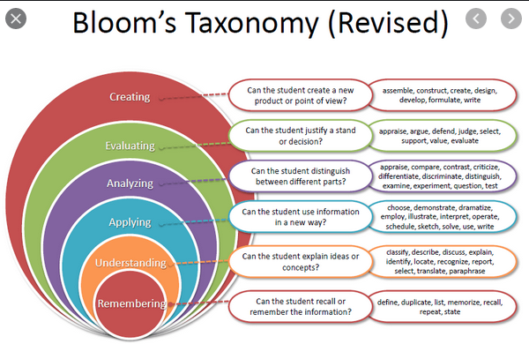
Assessment in HE
It should support higher-order thinking skills
Assessment is the weakest link in HE
A closed-book exam is still the most used assessment tool in HE
According to Bloom’s Taxonomy, higher order thinking skills (i.e., analyzing, evaluating and creating) are those leading to real and in-depth learning
Literature shows that using an open-book format could foster the above high-order thinking skills (for a systematic review comparing both types of exams see Durning, 2016)

Slide 20
A systematic review
A systematic review published in 2016 by Durning et al., evaluates and compares open book vs. closed ones. In brief, open book exams do allow the use of strategic questioning so to avoid that the students just regurgitate lecture notes. As most experts in the field recognize, open book exams support critical thinking (Johanns, 2017) and are a more ecologically valid form of assessment preparing students for the world of work and beyond. They also match many of the benchmark criteria proposed by the QAA Benchmarks Statements for Biomedical Sciences (2015).

Slide 21
Creativity needed to set up open book exam questions
Writing open book exam questions needs creativity and harder work to avoid a quick search in Google to answer or even worse asking dubious companies to answer in your place in exchange of money (Basken, 2020).
Here follows an example of a question for an open book exam I’ve used recently: “Remind yourself of Hieronymus Bosch painting ‘The cure of folly’ (1494): how far have we got in terms of understanding and treating mental illness from his times?”
(see panel on the left)

Slide 22
Assessment post-Covid
Remote online assessment under variable time conditions (from 1 hour to 24hrs)
How can we improve integrity, fairness and pedagogy?

Slide 23
How to improve fairness and integrity
How to improve pedagogy
Fairness
Every student needs to sit the online exam in the same conditions (e.g., on campus)
Integrity
avoid recall type of questions; apply word limits; ask for submission of personal artefact; demonstrate ownership in MCQs (add a part B, ask why); follow up with mini viva; review of similarity report; software with different levels of security
Open book exams need to constructively align to the learning outcomes
Carefully evaluate what skills, competencies we are expecting the students to demonstrate
Ensure the task assesses conceptual understanding

Slide 24
Mental Health post-Covid

Slide 25
Improving Mental wellbeing
Address problems as soon as they show
Create more opportunity for interaction with peers and staff alike
Foster a sense of belonging
Avoid overly dense lecture content with no rationale
Ensure fairness in the assessment process
What else?
For an up to date overview of how students have been affected by Covid-19 see Romeo et al., 2021

Slide 26
https://www.mind.org.uk/information-support/coronavirus/student-mental-health-during-coronavirus/

Slide 27
References
Anderson T., Rourke L., Garrison R.D.. & Archer W, “Assessing teaching presence in a computer conferring system”, JALN, Volume 5, issue 2, 2001
Bawa P (2016) Retention in online courses: exploring issues and solutions- A literature review. Sage Open Jan-Mar 1-11
Battaglia AA, “Critical thinking from bioscience undergraduate students’ perspective: a mixed method research study”, EDLULEARN 17. Iated Digital Library. Retrieved from: https://library.iated.org/view/BATTAGLIA2017CRI
Battaglia AA, “Assessment supporting higher-order thinking skills: evaluation of the introduction of an open-book final exam in a Neuroscience module for third year undergraduate students at King’s College London” INTED 2019, 7-9 March 2019, Valencia
Durning SJ, T. Dong, T. Ratcliffe, L. Schuwirth, A. R. Artino, J. R. Boulet and K. Eva, “Comparing open-book and closed-book examinations.’ Academic Medicine, vol. 91, no.4, pp. 583–599, 2016
Dupin-Bryant P.A. and DuCharme-Hansen B.A., “Assessing Student needs in Web-Based Distance Education”, JITDL, vol. 2, no.1, 2005
Jackel B, J. Pearce, A. Radloff and D. Edwards, “Assessment and feedback in higher eduction” A review of literature for the Higher Education Academy”, ACER, 2017. Retrieved from: https://www.heacademy.ac.uk/system/files/hub/download/acer_assessment.pdf
Krathwohl DR, “A revision of Bloom’s Taxonomy: An overview”. Theory into Practice, vol. 41, no. 4, pp. 212-218, 2002

Slide 28
References
Lenning O. and Ebbers,L., “The powerful potential of learning communities: improving education for the future.” ASHE-Higher Education Report, vol.26, no 6, 1999.
Neary M., Saunders G., Hagyard A. and Derricott D., “Student as producer: research-engaged teaching, an institutional strategy.” The Higher Education Academy, 2014
Neary, M. and Winn J., “The student as producer: reinventing the student experience in higher education” in The future of higher education: policy, pedagogy and the student experience. Continuum, London, pp192-210 (p201),2009.
Norris C & E Soloway ‘Schools, social learning and Socrates’ Available at: https://thelearningcounsel.com/article/school-social-learning-and-socrates
Rheingold et al., The Peeragogy Handbook, PubDomEd and Pierce Press, 2015, p. 9
Romeo M, Yepes-Baldo M, Soria MA, Jayme M ( 2021) Impact of the COVID-19 pandemic on HE: characterizing the psychosocial context of the positive and negative affective states using classification and regression trees. Front. Psychol., 1 Sept 2021, https://doi.org/10.3389/fpsyg.2021.714397
Yuval Noah Harari on COVID-19's Impact on Humankind: an interview by J Corden available at https://www.youtube.com/watch?v=sRRhvwkV7L0
Wang X, Liu T, Wang J & Tian J (2021) Understanding Learning continuance intention: A comparison of live video learning, pre-recorded video learning and hybrid video learning in Covid-19 pandemic. International Journal of Human-Computer interaction, 1-19 Doi: 10.1080/10447318.2021.1938389
West R.E & Williams G., “I don’t think that word means what you think it means: a proposed framework for defining learning communities”, Educational Technology Research and Development, 2018, available online at https://edtechbooks.org/-hA
https://www.ons.gov.uk/peoplepopulationandcommunity/educationandchildcare/articles/coronavirusandtheimpactonstudentsinhighereducationinenglandseptembertodecember2020/2020-12-21

Slide 29
THANK YOU! Please email me your ideas or questions at: anna.battaglia@kcl.ac.uk

