Slide 1
King’s Clinical
Academic
Training Office
(KCATO)
Welcome to King’s
IAT Induction
Kcato@kcl.ac.uk
@Kings_CATO
KCATO Hub
Notes:
This slide deck is for others to use – so please take your name off?
Suggest add the KCATO email on the front slide though.

Slide 2
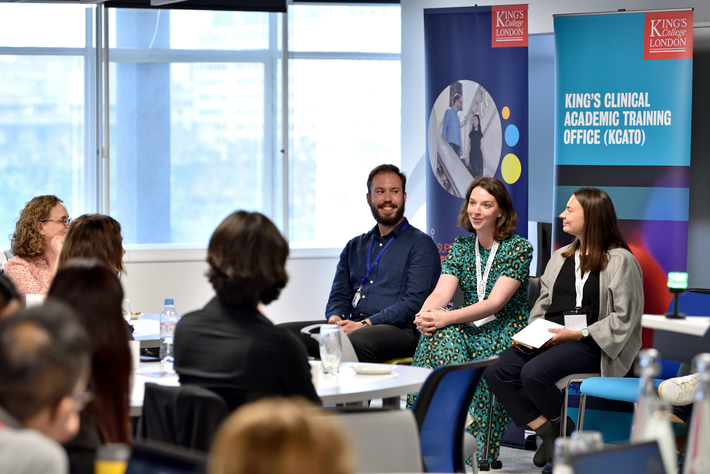
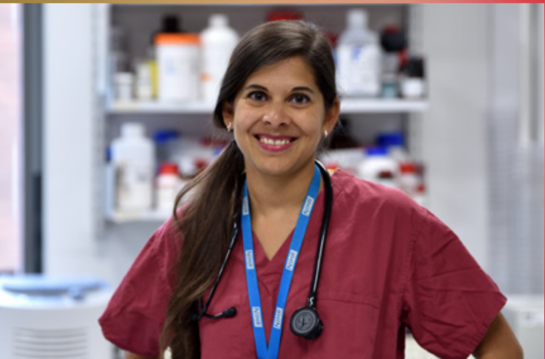
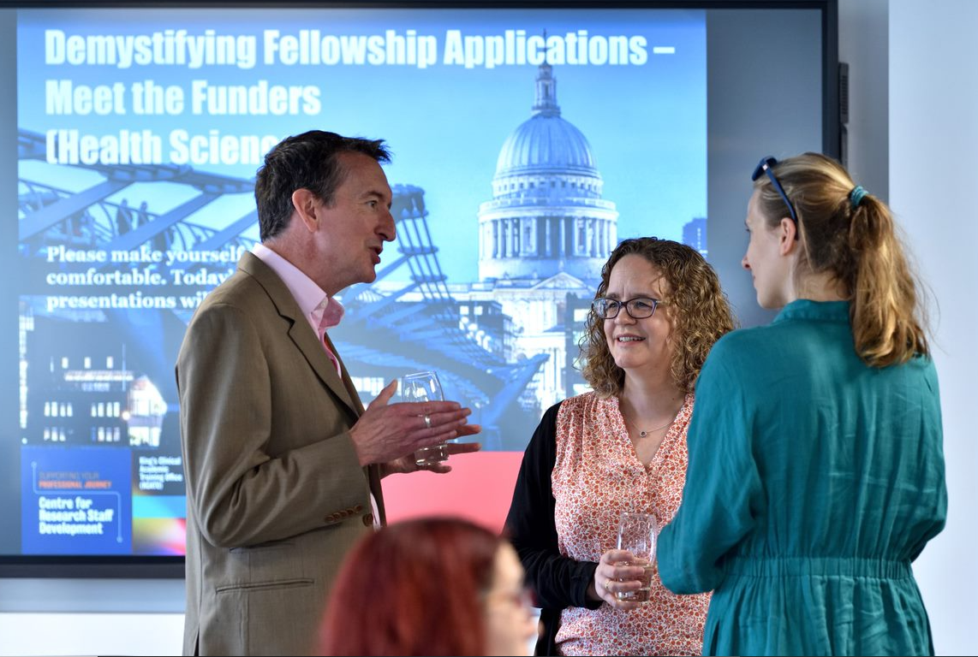




King's Clinical Academic Training Office (KCATO)
Mission: To facilitate and support world-class pan-professional clinical academic training
across King’s College London and its NHS partner Trusts,
enabling all health professional disciplines to become clinical academic leaders of the future
kcato@kcl.ac.uk
www.kcl.ac.uk/kcato
@Kings_KCATO
kingscato
Signup for our quarterly Newsletters!
in

Slide 3
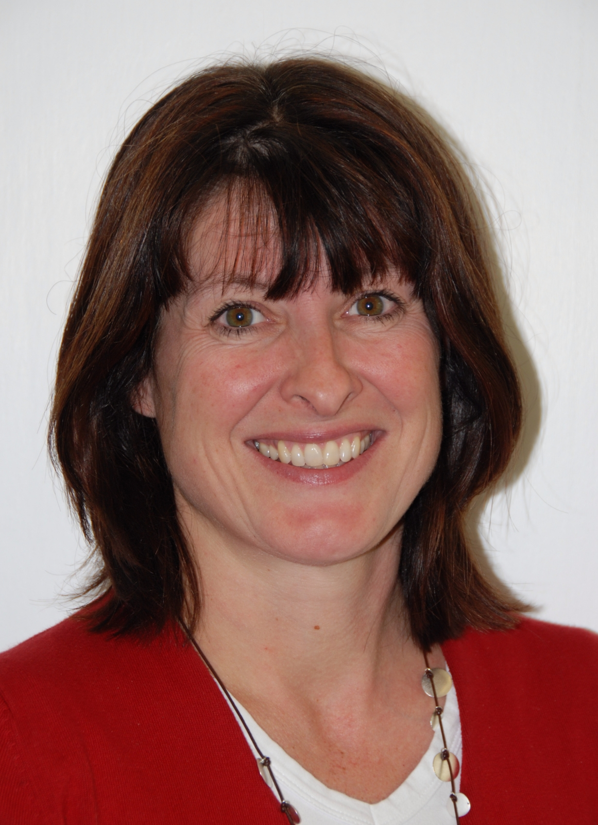
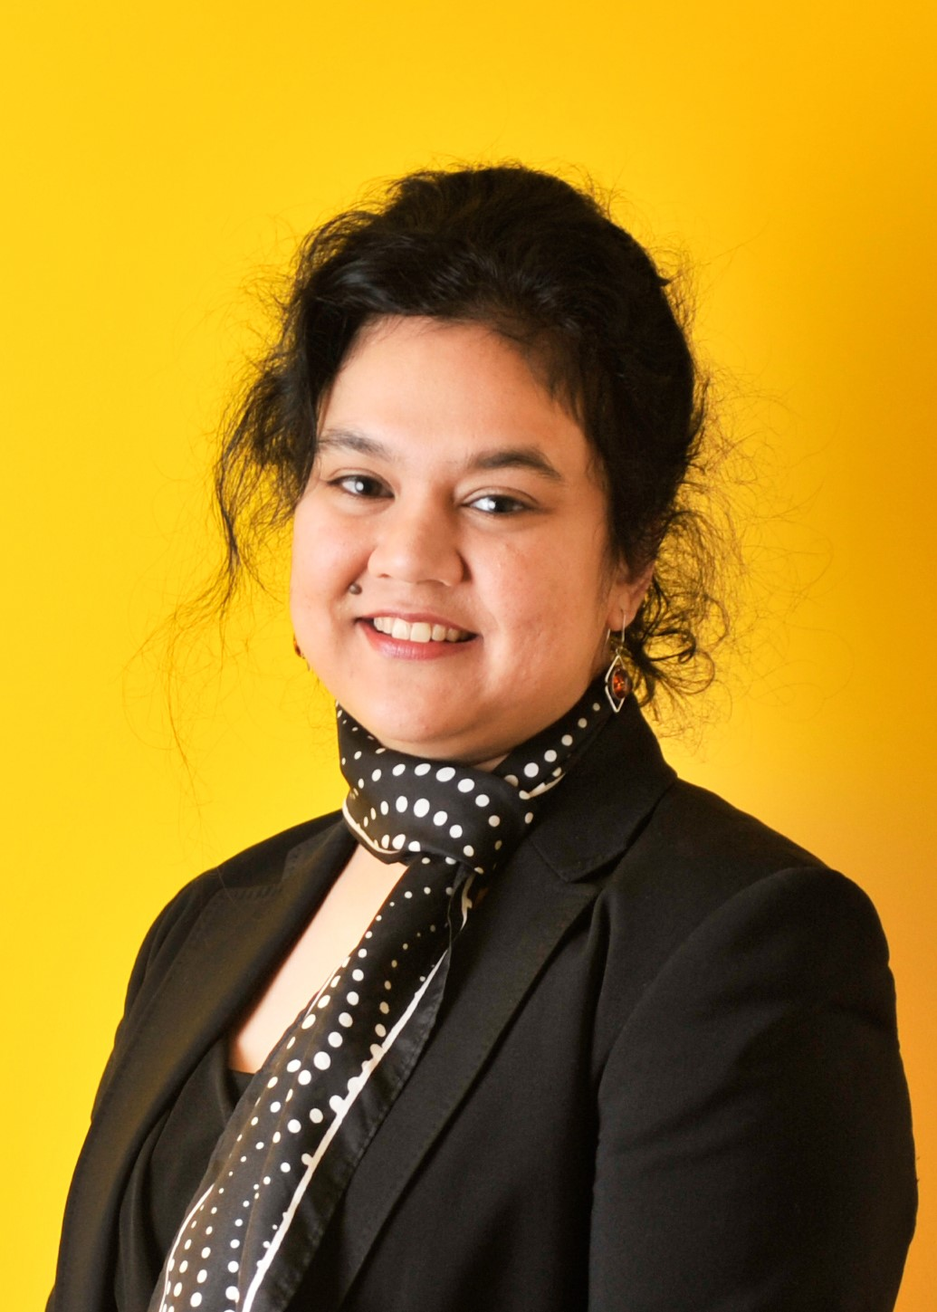
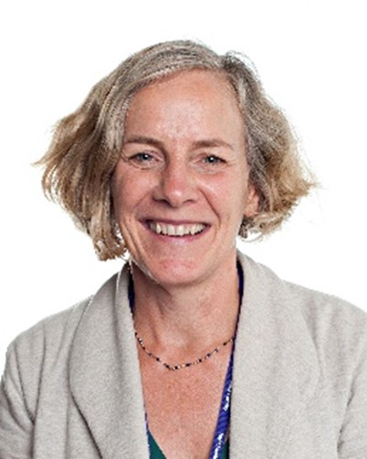
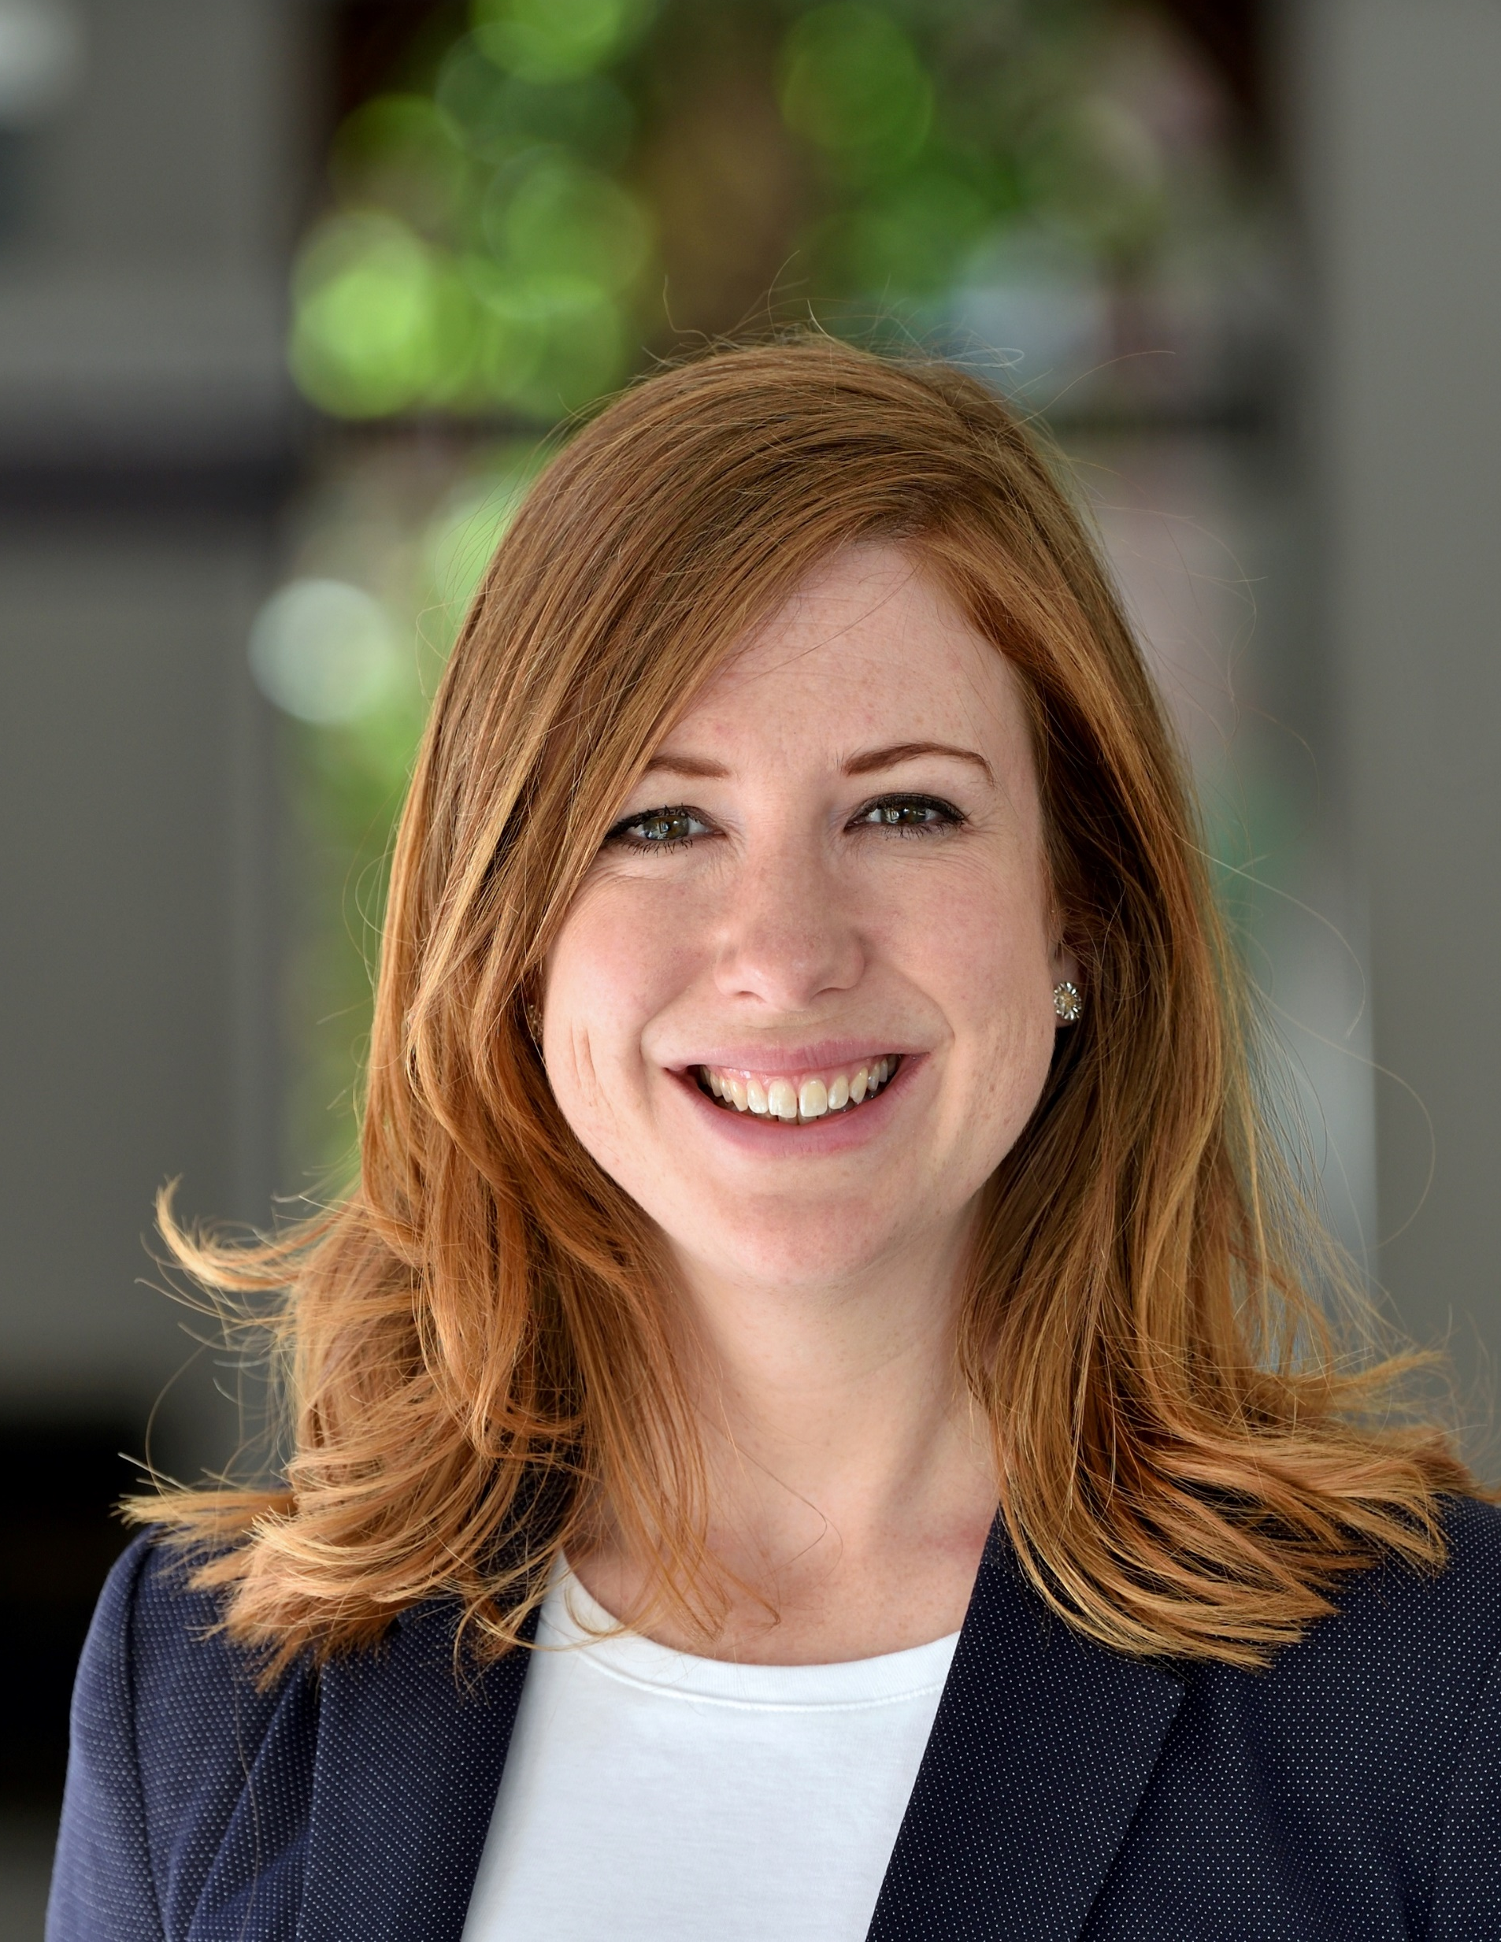
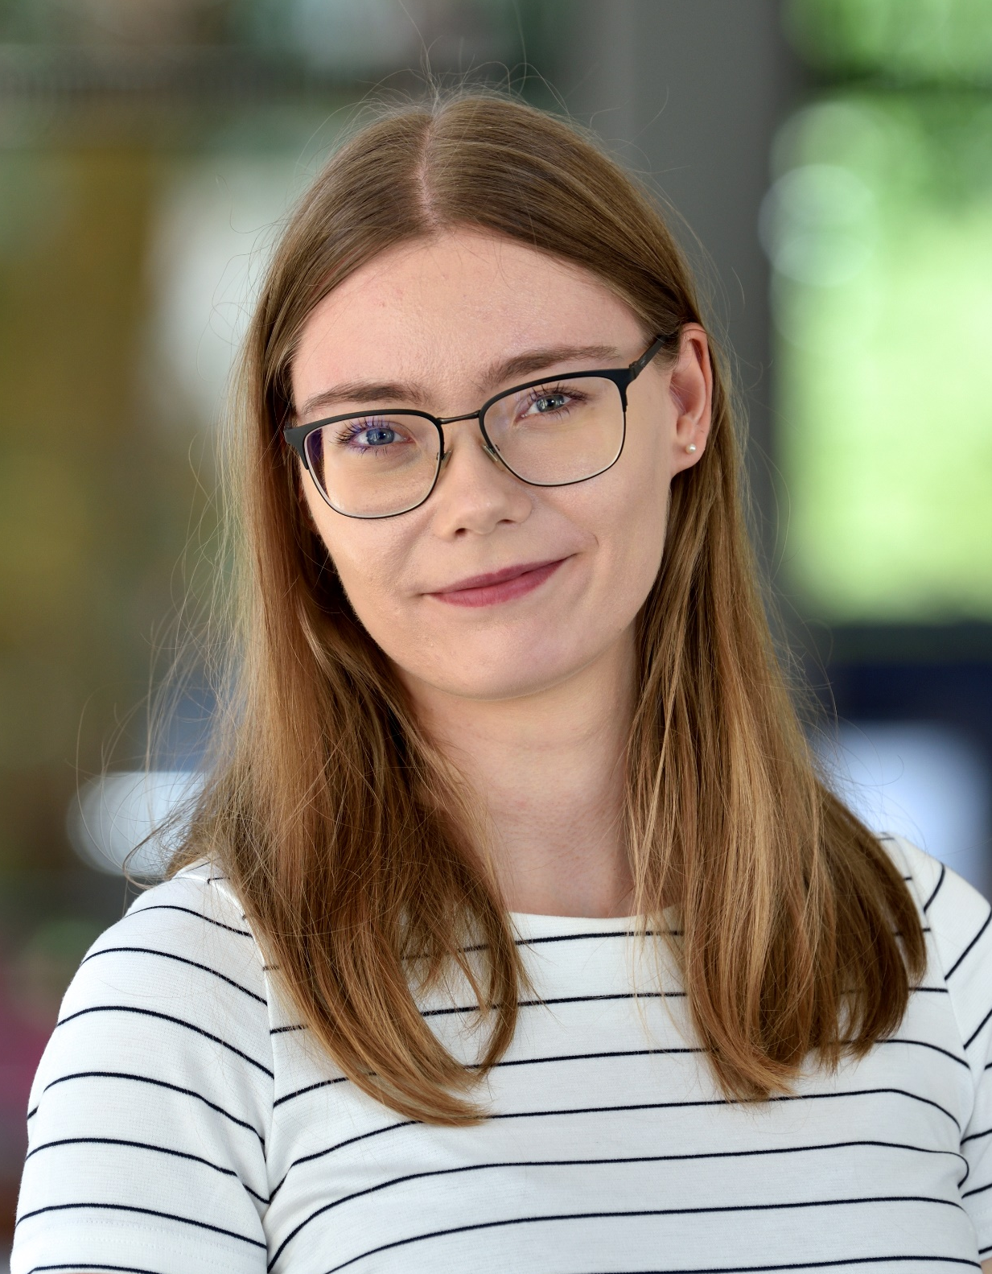
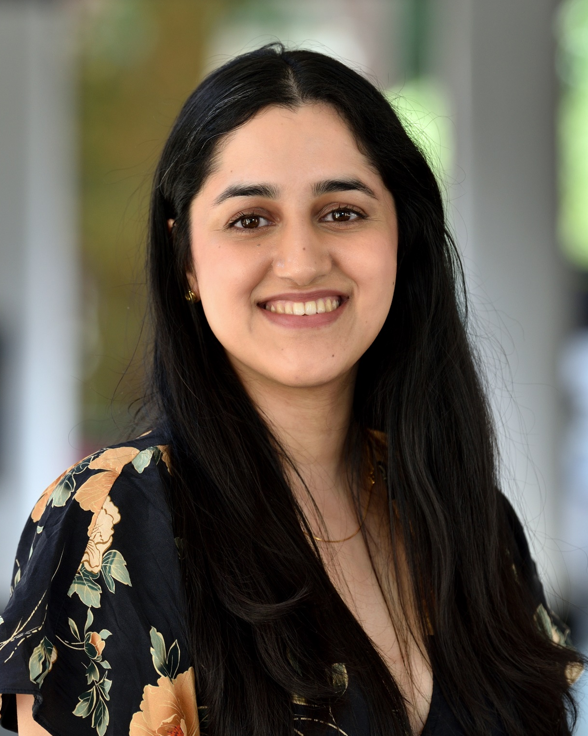
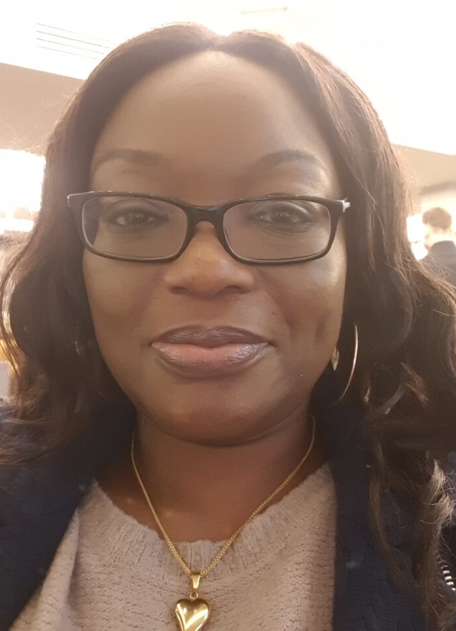
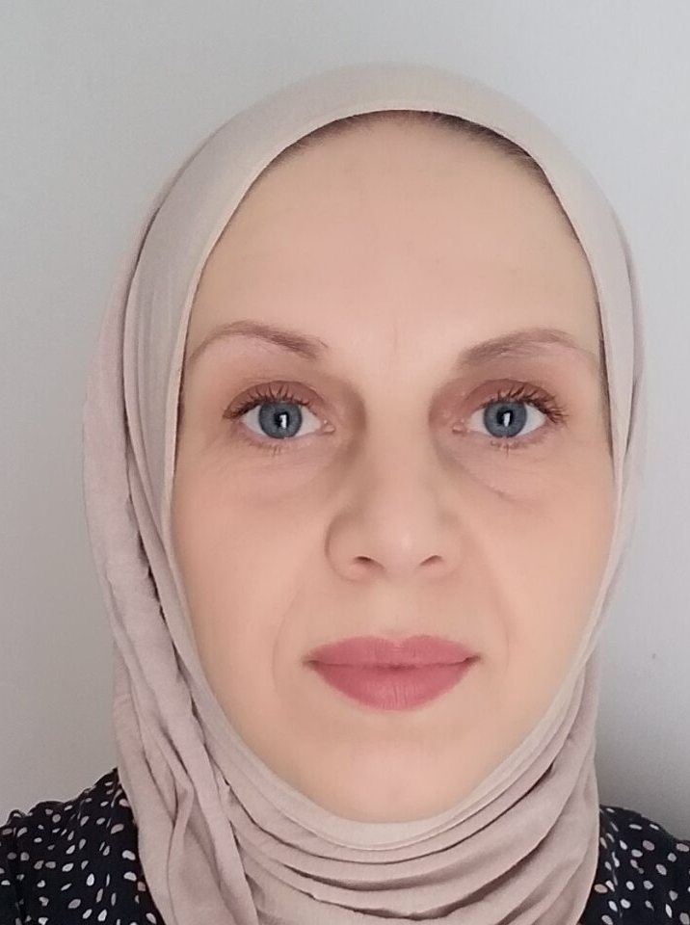
KCATO Team
Prof Frances Williams (KCATO Director)
Dr Rina Dutta and Prof Catherine Evans (KCATO Deputy Directors)
Dr Amy Moore (Chief of Staff – Health Sciences; Associate Director - Doctoral Environment & Development)
Nora Park and Dr Gursimran Oberoi (KCATO Manager)
Sheila Adeyemi and Kasia Bojko (IAT Programme Officer)

Slide 4
The KCL IAT Programme
Joint IAT Leads at KCL:
Prof Frances Williams (KCATO Director
Dr Rina Dutta (KCATO Deputy Director)
IAT Programme Officers
  Sheila Adeyemi (CLs, bursaries, recruitment)
  Kasia Bojko (ACFs, PG Cert, induction)

Slide 5
King’s IAT programme is highly successful
The King’s IAT programme has been running for 17 years and has trained over 350 clinical academics.
More than 90% of previous trainees remain active in research.
King’s trainees and alumni of the scheme have authored more than 9,000 peer-reviewed articles since 2010
They are principal investigator or co-investigator on research grants totalling more than £160M

Slide 6
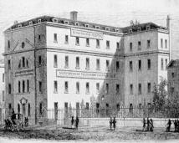
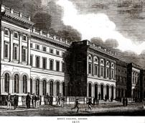
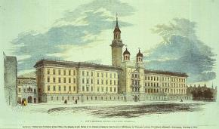
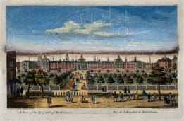
King’s College London
One of the two founding colleges of the University of London in 1836
Founded in 1829 by King George IV and the Duke of Wellington, who fought in a duel in defence of his role in the establishment of the College

Slide 7

Faculties
Faculty of Arts & Humanities
Faculty of Dentistry, Oral & Craniofacial Sciences
King’s Business School
Faculty of Life Sciences & Medicine
Faculty of Natural, Mathematical & Engineering Sciences
Florence Nightingale Faculty of Nursing, Midwifery & Palliative Care
Institute of Psychiatry, Psychology & Neuroscience
Faculty of Social Science & Public Policy
The Dickson Poon School of Law

Slide 8
Faculty of Life Science and Medicine
One of the largest and most successful centres for research and education in the UK.
School of Basic & Medical Biosciences
School of Biomedical Engineering & Imaging Sciences
School of Cancer & Pharmaceutical Sciences
School of Cardiovascular and Metabolic Medicine & Sciences
School of Immunology & Microbial Sciences
School of Life Course & Population Sciences

Slide 9
Institute of Psychiatry, Psychology & Neuroscience (IoPPN) – 3 Academic Schools
School of Academic Psychiatry:
Department of Addictions Sciences
Department of Child & Adolescent Psychiatry
Department of Forensic and Neurodevelopmental Science
Department of Old Age Psychiatry
Department of Psychological Medicine
Department of Psychosis Studies
School of Mental Health & Psychological Sciences:
Department of Biostatistics & Health Informatics
Department of Health Service and Population Research
Department of Psychology
Social, Genetic & Developmental Psychiatry Centre
School of Neuroscience:
Centre for Developmental Neurobiology
Department of Basic & Clinical Neuroscience
Department of Neuroimaging
Wolfson Centre for Age-Related Diseases

Slide 10
The Faculty of Dentistry, Oral & Craniofacial Sciences
One of the world’s centres of excellence for dental education, oral and craniofacial scientific research, and oral healthcare provision, ranked 1st globally for dentistry in the QS World University Rankings 2020.
Departments:
Craniofacial & Regenerative Biology
Dental Education
Host-Microbiome Interactions
Oral, Clinical & Translational Sciences

Slide 11
Florence Nightingale Faculty of Nursing, Midwifery & Palliative Care
Descended from the training school Florence Nightingale set up at St Thomas’ Hospital in 1860
The Cicely Saunders Institute was established in 2010 with the international charity she founded and is the world’s first purpose-built institute for palliative care.
Both Florence and Cicely were multi-professional pioneers who used data to change practice and improve health and care

Slide 12
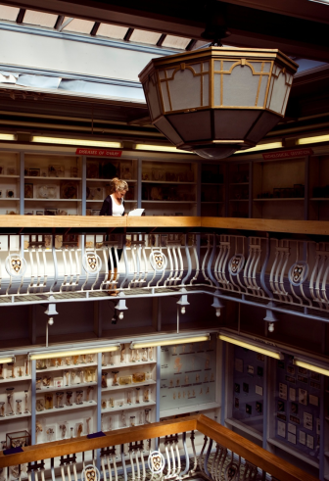
Gordon Museum of Pathology and Museum of Life Sciences

Slide 13
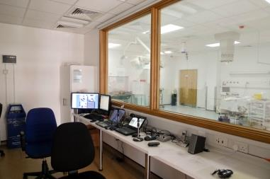
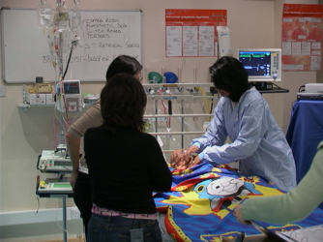
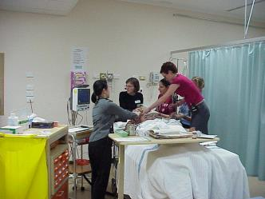
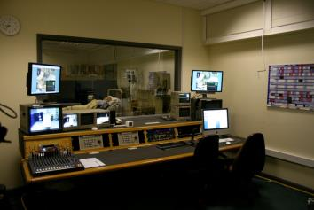
SaIL Centre

Slide 14

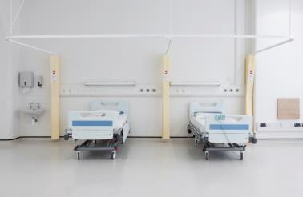
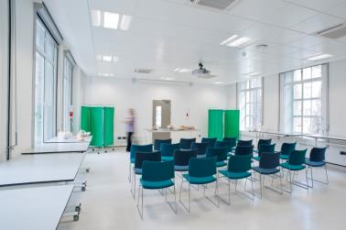
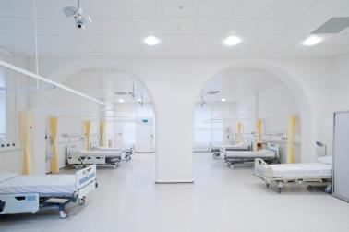
Chantler Simulation & Interactive Learning Centre

Slide 15
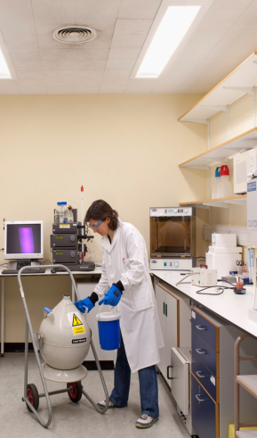
Centres of Excellence
NIHR infrastructure:
NIHR Maudsley Biomedical Research Centre
NIHR Bioresource and NIHR Mental Health Translational Research Collaboration.
Two NIHR Clinical Research Facilities: one MHRA Phase-1 accredited with specialist expertise in advanced therapies, one with specialist capabilities in mental health and neuroscience
IHR Applied Research Collaboration South London
Research infrastructure funded by UKRI and major charities including:
Advanced Therapies Accelerator
Comprehensive Cancer Centre
Neuropsychiatric Hub
London Institute for Healthcare Engineering
MRC/LifeArc/BBSRC Gene Therapy Innovation Hub
Experimental Cancer Medicine Centre
Innovate UK AI Centre for Value-Based Healthcare
Wellcome Centre for Medical Engineering ….. And many more!

Slide 16
Local IAT Organisation

Slide 17
Class of 2023/24

Slide 18
Integrated Academic Training Path

Slide 19
Integrated Academic Training Path

Slide 20
NIHR Academic Clinical Fellow
Usually pre-doctoral clinical academic trainee, but can be appointed with PhD
Can be appointed at any level, includes run-through training
25% time carrying out research, usually as 3 month blocks per year, combined with clinical training for up to 3 years
Aim is to obtain a Clinical Research Training Fellowship or other funding to complete PhD/MD(Res)

Slide 21
NIHR Clinical Lecturer
Post-doctoral clinical academic trainee
Hold an NTN or been benchmarked through the appropriate nationally agreed process prior to appointment
50% time carrying out research, combined with clinical training, organised to suit the trainee’s needs
Maximum time 4 years, provided that ongoing clinical training is required
Aim is to obtain a Clinician Scientist Fellowship or Clinical Senior Lectureship

Slide 22
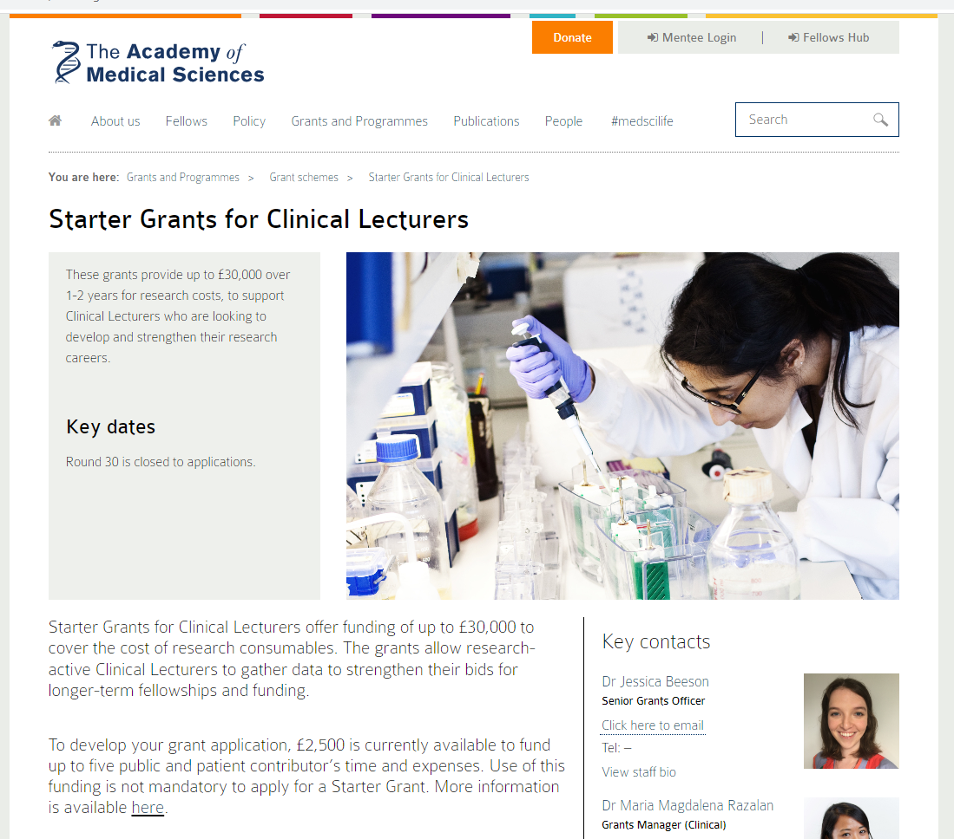
AMS Starter Grants
https://acmedsci.ac.uk/grants-and-schemes/grant-schemes/starter-grants

Slide 23
Common Features of ACF and ACL
Trainees must be assessed as per standards laid out in Gold Guide
  Both clinical and academic training must be assessed
Trainees entitled to NIHR Trainees Co-ordinating Centre funded bursary
  Does not cover mandatory clinical training
Bench fees available to support basic research costs
Access to research training opportunities

Slide 24
Research Blocks Abroad
A small number of past ACFs have undertaken research blocks abroad.
If you feel your research would require you to take a research block abroad please note the following:
You must discuss this decision with your Academic Lead as a first point of contact
The decision to carry out research abroad must be approved by the ACF Programme Lead
No funding will be available to support overseas research

Slide 25
Bursary Funding
ACFs and CLs can apply for up to £1,000 per year
Applications should always be prospective, at least 2 months in advance of the event
For large future expenses, trainees can apply to roll over unused funds to the next financial year before the 1st April
Trainees are able to use their allowance to fund a course/training which is not available to them at King’s
Expenses are reimbursed via the expenses claim process

Slide 26
Research Support Funding
Funds to facilitate work with a supervisor
Costs directly relevant to the research project
(operational costs should be funded by your department)
Trainees may claim up to a total of £750 (ACFs); £1,500 (CLs)
Research Support Funds do not cover buying a laptop
Two stage application process –
Phase I
Suitable project proposal and budget
Phase II
Evidence of progress in project and academic development + academic outputs

Slide 27
Additional Information
Applications are reviewed on a monthly basis
Applications exceeding the maximum £ allowance will not be approved
Forms must be signed and dated by trainee and supervisor
Original receipts or invoices must accompany each expenses claim
  Note that AirBnb is not permitted under KCL travel policy

Slide 28
Key Strategic Priorities and Cross-Cutting Themes
Champion Clinical Academic Careers
Capacity Building
Deliver and Promote Bespoke Career Development
Central Visible Contact Point
Partnership working - local, regional and national
Equality, Diversity & Inclusion
Data driven approach
Notes:
Removing Barries
NMAHPs and EDI
Recruitment & Retention
Improving Policy & Processes
Creating Opportunities
Celebrating Health Professional Researchers
Career Stories
Mentorship
Career Management
Funding
Research Training Programmes
Fellowship Application Support
Bursaries/Grants
Bespoke Training
Workshops
On-Demand
Community Building
Annual Conference
KCATO Networking Events
News
KCATO Hub
local, regional, national
Roadshows
KCATO Stands at External Events

Slide 29

Deliver and Promote Bespoke Career Development
Bespoke training and resources e.g., Advancing in Academia
Signposting and access to existing support (from KCATO and King's Partners – e.g., KHP Learning Hub, Health Sciences DTC)
Networking and events e.g., Meet the Funders
Online, in-person and on-demand resources

Slide 30
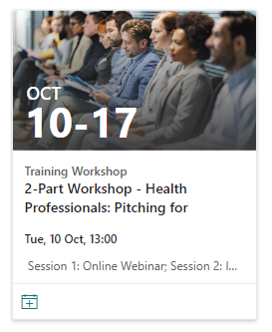
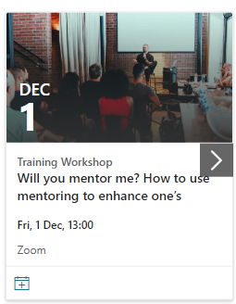

Upcoming KCATO Opportunities
These resources and more available on KCATO Hub!

Slide 31
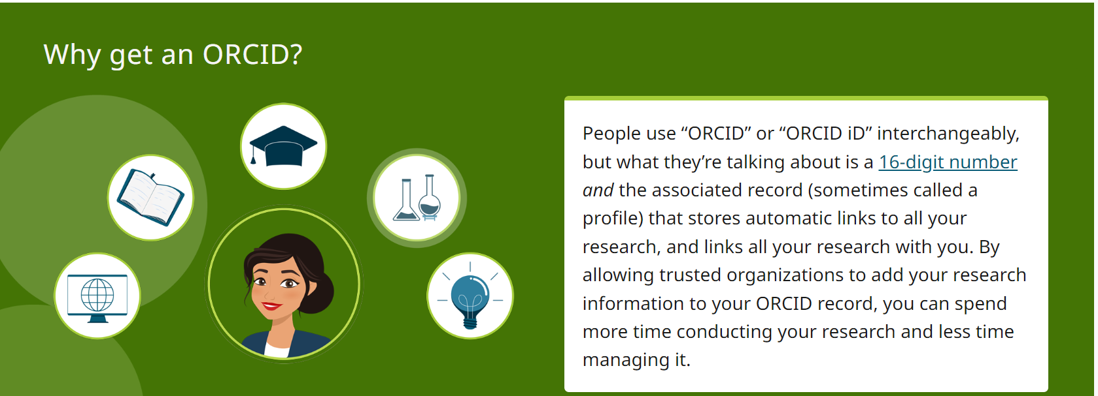

Slide 32
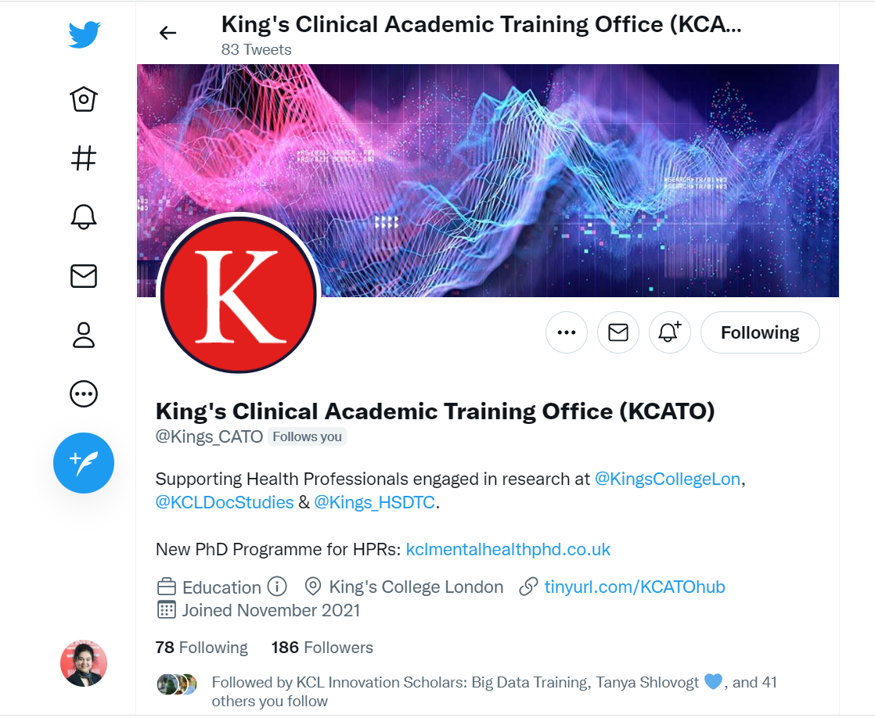
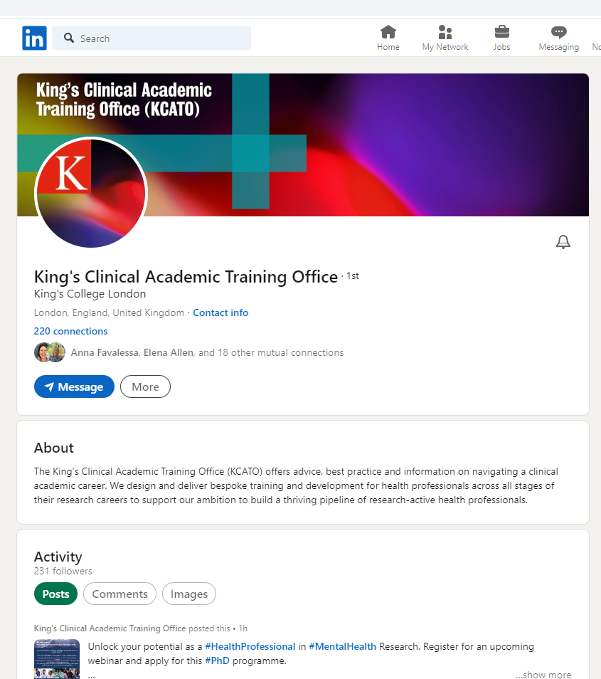
Newsletter, LinkedIn, Twitter

Slide 33
Further Information and Contacts
Funding web address:
https://internal.kcl.ac.uk/lsm/staff/teach/iat/funding/index.aspx
Contact details:
IATadmin@kcl.ac.uk

