Slide 1

King’s College e-Tendering Website https://in-tendhost.co.uk/kcl/
Click mouse to continue
This short presentation gives a brief overview on how to use the e-tendering website.
Further information on conducting business is available at: http://www.kcl.ac.uk/aboutkings/orgstructure/ps/purchasing/suppliers/etender.aspx
From the e-tendering web site suppliers can:-
  View all forthcoming and current tenders at King’s College London.
  Register your company details.
  Express Interest in any of the current tenders.
  Tender documentation will be downloaded to the secure area of the web.
  Tender submissions will be uploaded to the University via the secure area of the web site.
  Manage your company details including adding and removing contacts.
  Raise correspondence in relation to tenders and contracts.
Before you can participate in a tender you must register your details on the system.
Following initial registration you should not register your company details again, use your username and password as issued at initial registration. There is a “forgotten username / password” facility available on the Login box.
Help may be obtained at any time by clicking on the help tab throughout the system to give you further guidance.

Slide 2
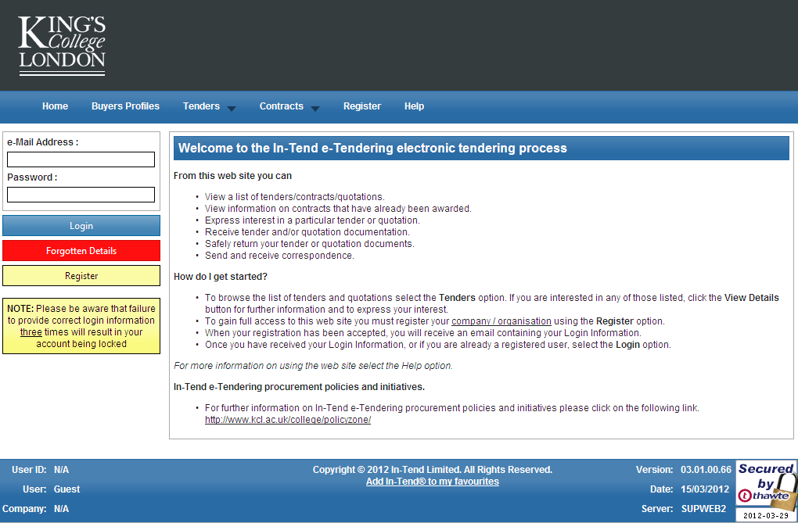
King’s College London eTendering Home Page
Log in to the system here
View forthcoming and current projects here
View current contracts here
Register your details here

Slide 3
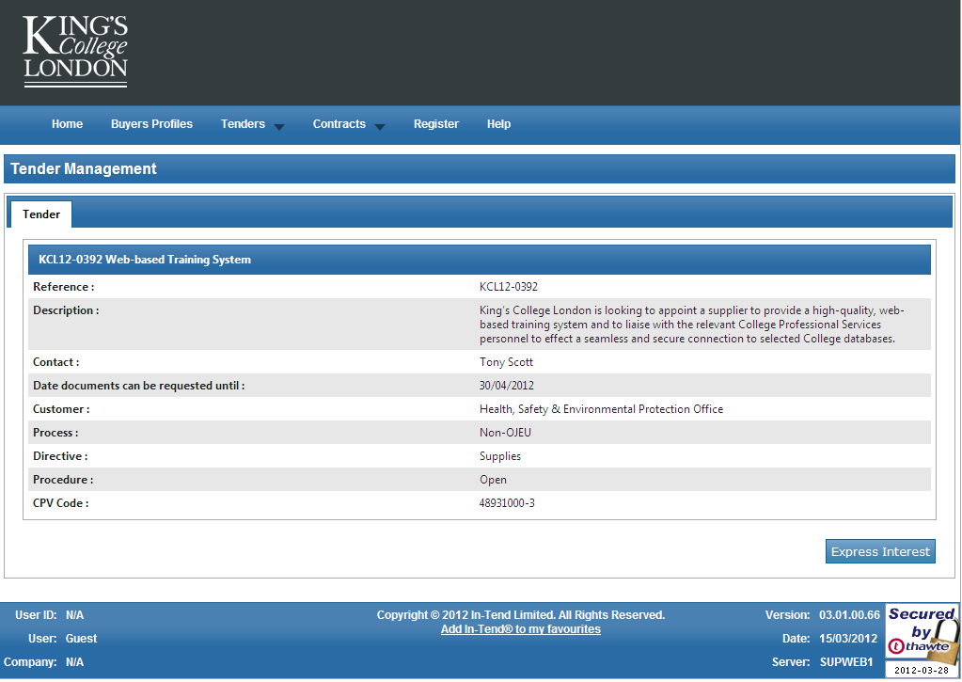
Clicking on the Tenders tab allows you to see all forthcoming and current opportunities along with brief details of the project. At this point you do not have to enter any details about your company but if you want to express interest, you will be prompted to register on the system or insert your username and password
Click here to express interest

Slide 4
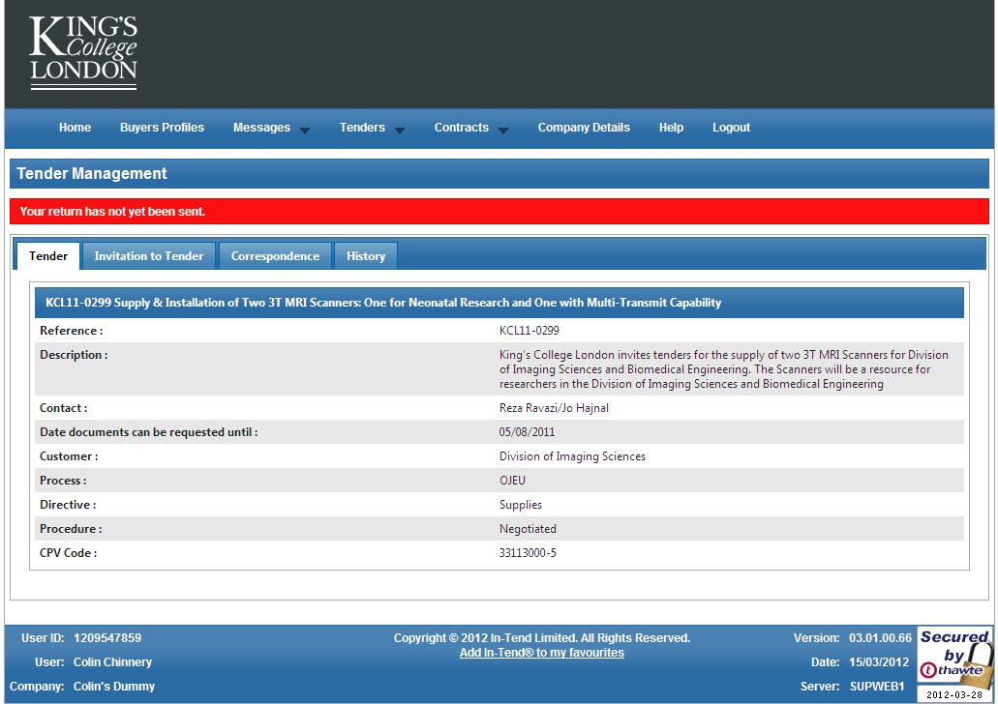
Once you have logged in and expressed interest, all information will be available by clicking the appropriate tab
Stage Tab: every stage of the project will have a tab where further information and documentation can be found about the stage. This is also where you submit your return(s)
Correspondence Tab: All correspondence associated with the project can be found here. There may also be a Clarifications tab adjacent to this
History Tab: all significant dates are recorded here for your information

