Slide 1
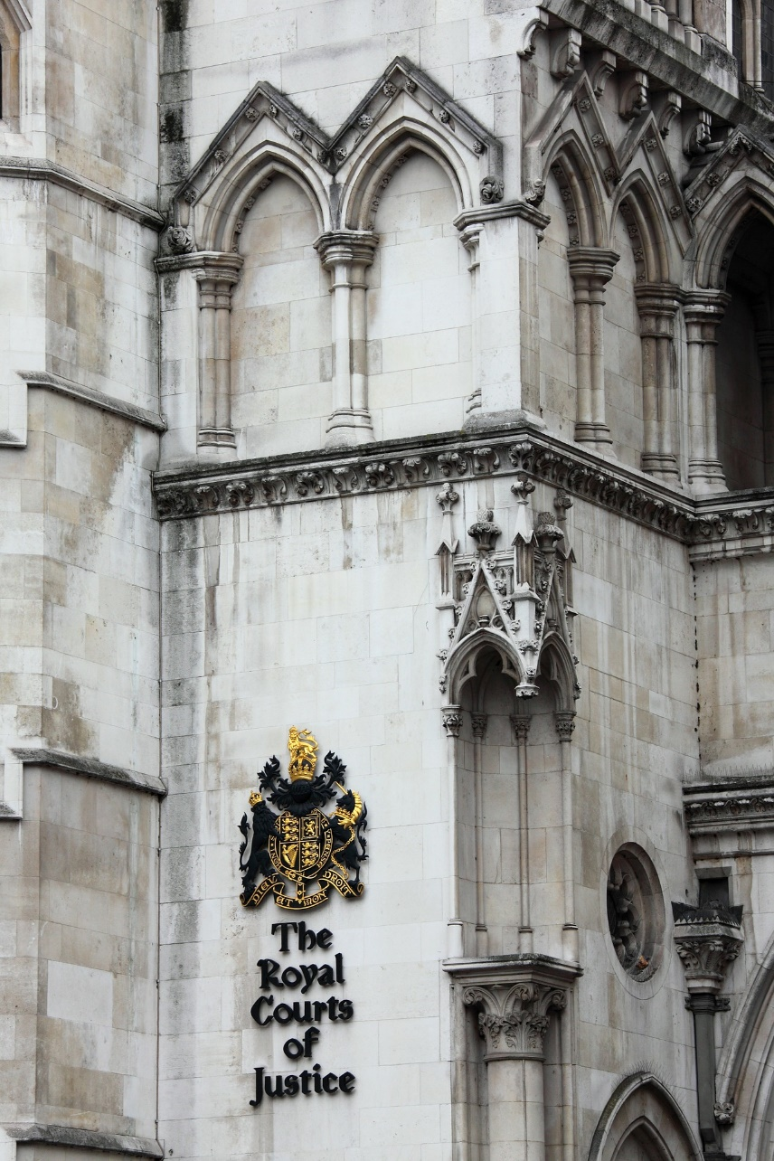
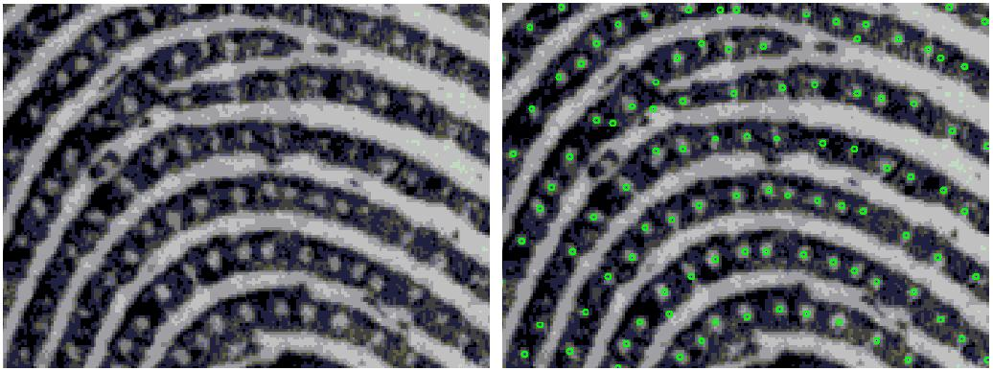
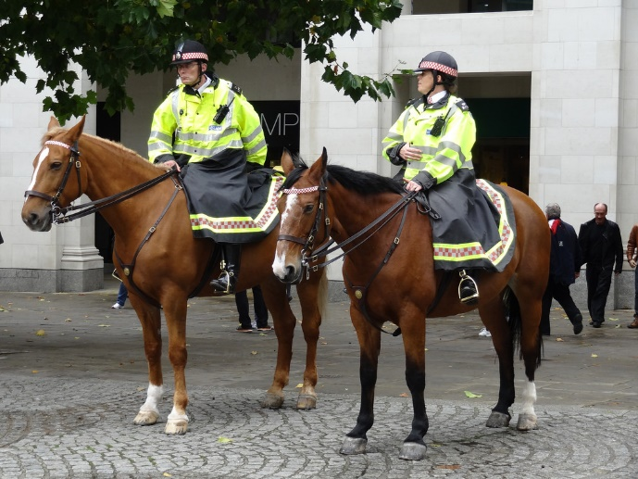
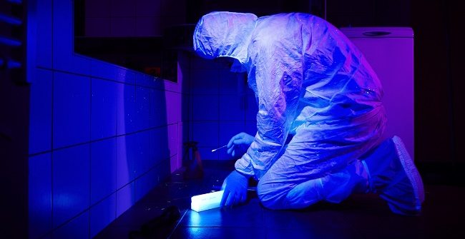

Slide 2
Tracy Alexander
Director of Forensic Services at the City of London Police
High tech digital and cyber crime
Coronial investigations
Scenes of crime
Fingerprint bureau
Chemical enhancement laboratory

Slide 3
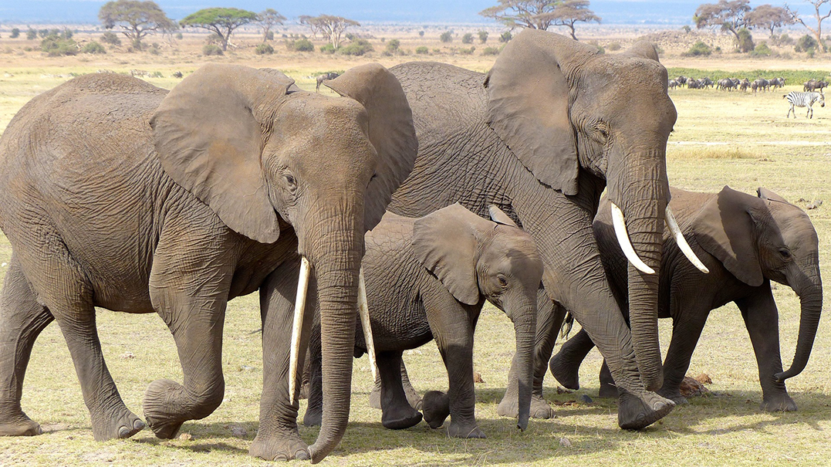
2010 – 2012:
100,000
elephants killed for ivory
2016 Record quantity of ivory seized (nearly 40 tonnes)
Gradual decline in poaching since 2012, but no decline in demand.
Estimated
55 elephants killed illegally every day
Notes:
General info: in the early 1900s African Elephant populations were estimated to be in the millions. According to World Wildlife Fund, today there are around 700,000 African Elephants in the wild.
In 1989, CITES (Convention on International Trade in Endangered Species of Wild Fauna and Flora) banned the international ivory trade. Yet poaching for ivory has been steadily increasing, with 800,000 African elephants killed over the last three decades.
In 1989, the U.S. Congress passed the African Elephant Conservation Act, which was aimed at improving elephant African elephant populations. Parts of the act include reducing the ivory trade and supporting African conservation efforts. Unfortunately, the Trump administration reversed a ban on elephant trophy imports in 2017, saying that hunting African elephants in Zimbabwe and Zambia “will enhance the survival of the species in the wild.”
Some other facts (about elephants, not Trump – we won’t go there):
The word “elephant” comes from the Greek word “elephas” which means “ivory”.
African elephants are divided into two subspecies: savannah (bush) and forest. Savannah elephants are larger, with curved tusks, while forest elephants are smaller, with tusks that are straighter and point downward.
An adult male’s tusk grows about 7 inches each year on average
Some are left-tusked, others are right-tusked. They’ll favor that tusk when fighting other Elephants, picking things up, or stripping leaves and bark off trees. Because of constant usage, their preferred tusk gets shorter over time.
An Elephant’s tusk can weigh up to 22 pounds. Each one is worth $10,000-$15,000 on the black market in Asia, where they are used to make everything from billiard balls and piano keys to chopsticks.
Reasons for decline in killing: most notably due to government intervention and tighter restrictions, closures of domestic ivory markets – conversely trafficking still remains as large now as it has done and one possible explanation is that crime gangs are panic selling - so much so that one report reveals 2016 as recording highs for the amounts of ivory trafficked across the globe over the past decade.
Eastern Africa acts as the maritime gateway to the east where the majority of demand lies. Forensic DNA work already conducted originates a lot of the seized ivory to Central Africa. This process, whilst able to generate large amounts of data, is costly and could be further developed using cheaper, evidential data.
The Elephant Trade Information System (ETIS), managed by CITES, suggests the average ivory seizure to be 500kg which equates to about 90 tusks. Between 2009-2014, there were 91 such shipments totalling 159 metric tonnes of ivory seized globally, representing ivory from at least 15,900 elephants.
However, using the Proportion of illegally killed elephant scores (PIKE) it suggests that only about 10% of ivory flow is seized, that’s still a vast amount of intelligence and evidence that has yet to be harvested.
The predominance of large scale seizure in the seizure total and the geographical concentration of poaching suggests a market controlled by a limited amount of players
People conducting the poaching cannot be described succinctly. Without direct links to destination markets, poachers would be paid minimal rates, however if the current estimate of 10% of the final retail price is accurate, they would earn collectively between 10-40 million US dollars a year.
The United Nations has emphasised the role of security officers and media have also reported incidents where rangers, responsible for protecting wildlife populations were found to be active in poaching.
It is therefore reliable to assume to that these limited amount of players are directly linked or are themselves organised crime syndicates which as we know promote amongst others;
Corruption
Terrorism
Slavery

Slide 4
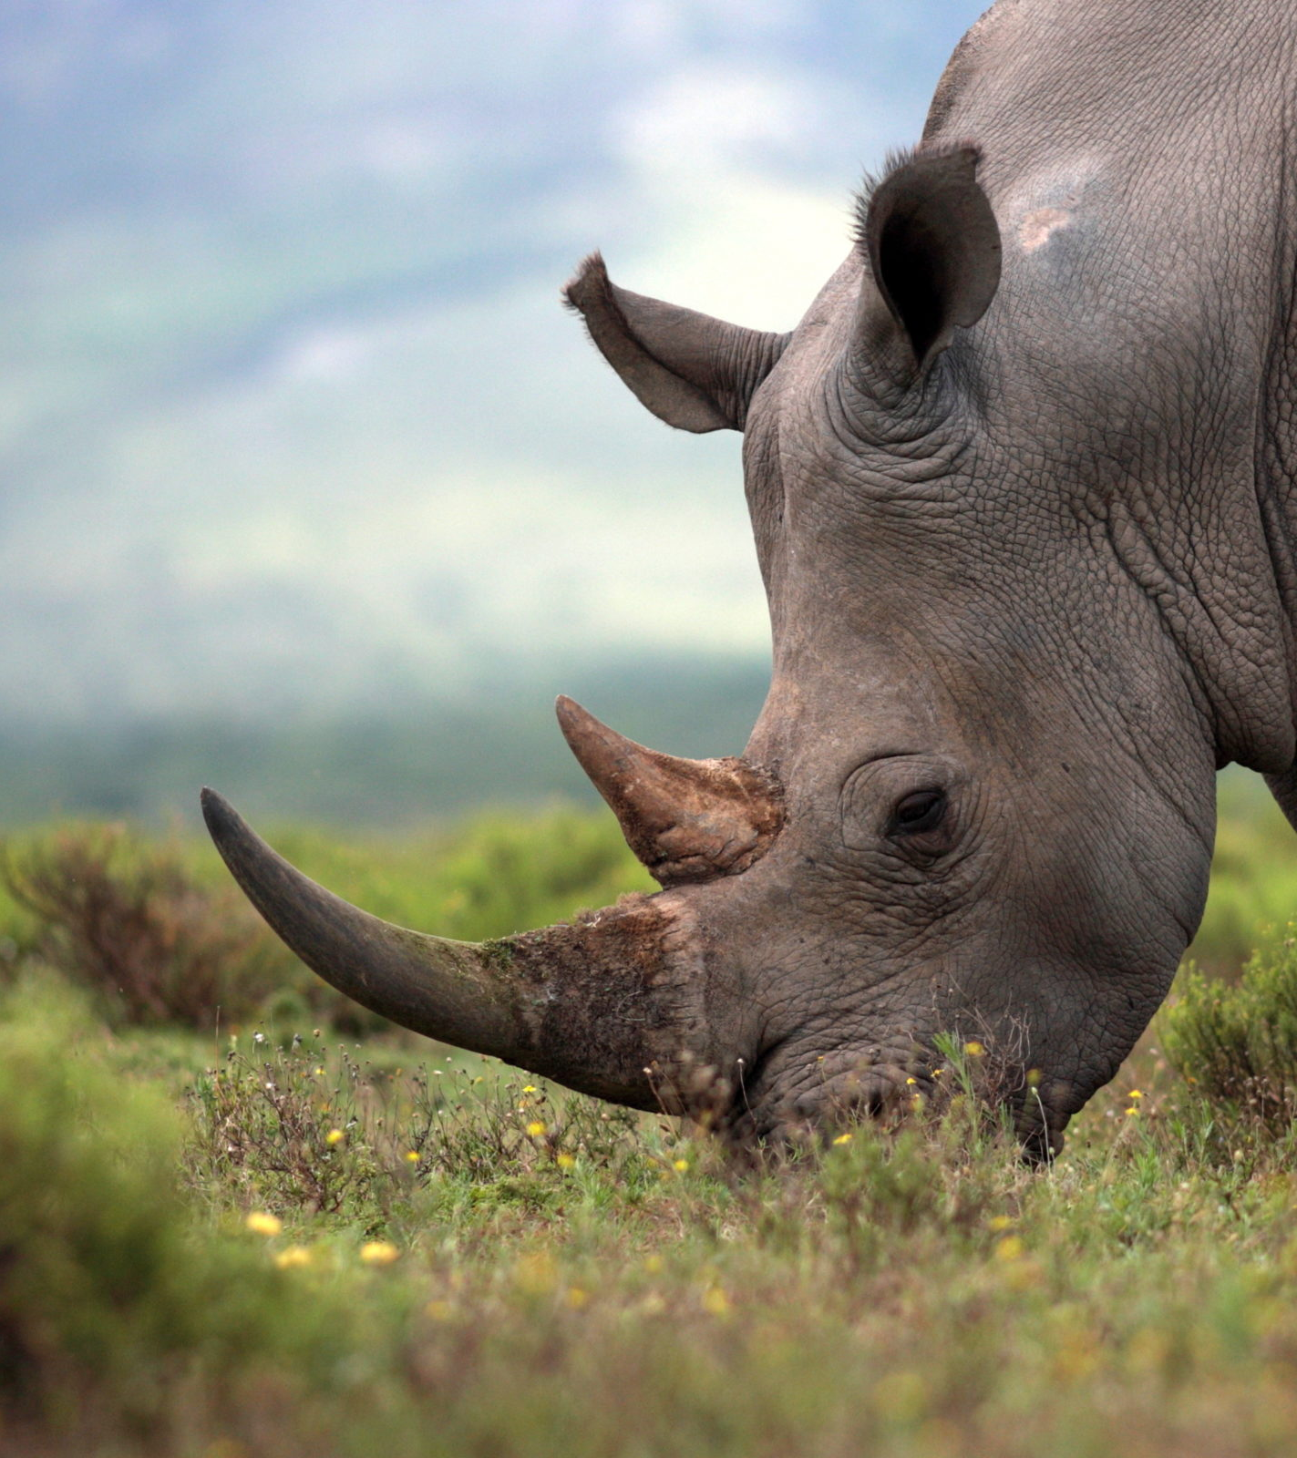
c.27,000 rhinos remain in the wild
Serious and Organised Crime
Black and White rhino horn
Value
How many rhinos left?

Slide 5
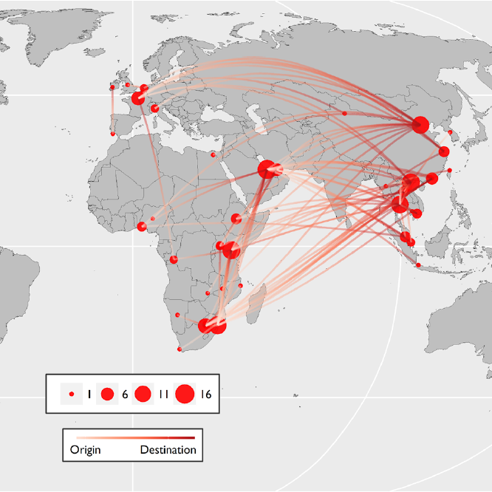
Where is this happening?
Routes for drugs and people tested with wildlife crime goods
Flow of goods to Asia
Source: Flying under the Radar, Wildlife Trafficking in the Air Transport Sector, Mary Utermohlen & Patrick Baine, (2017). TRAFFIC. Cambridge, UK

Slide 6
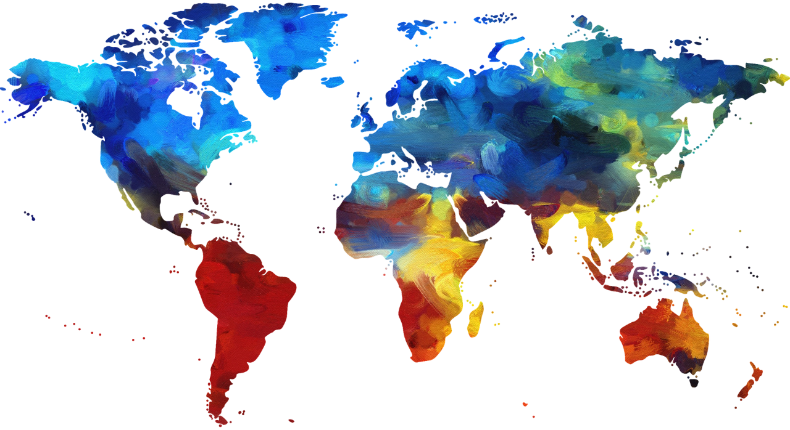
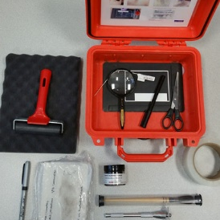
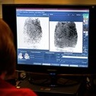
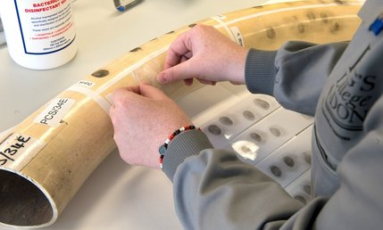
Notes:
The UK has the resources to assist and capability to introduce fingerprinting and forensics to nations that don’t

Slide 7
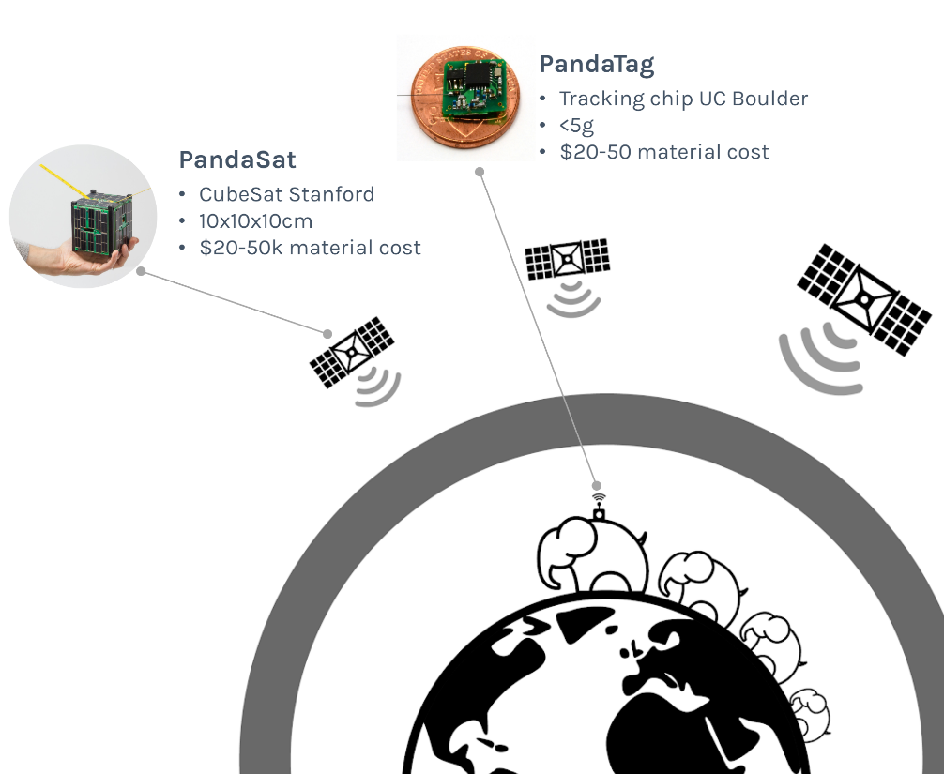
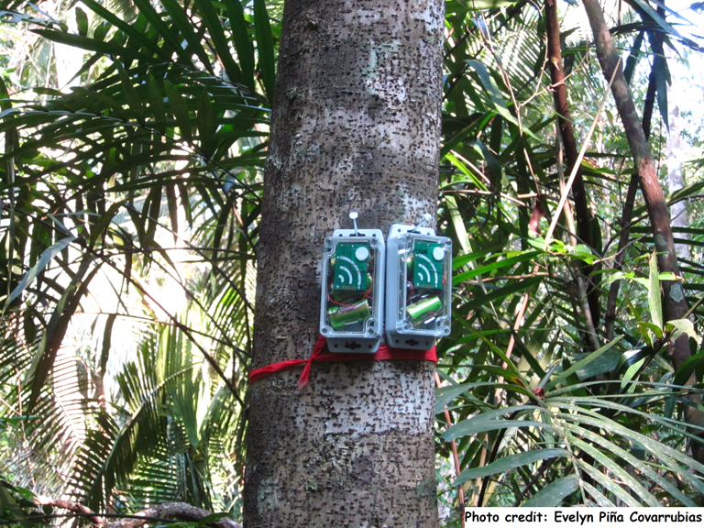
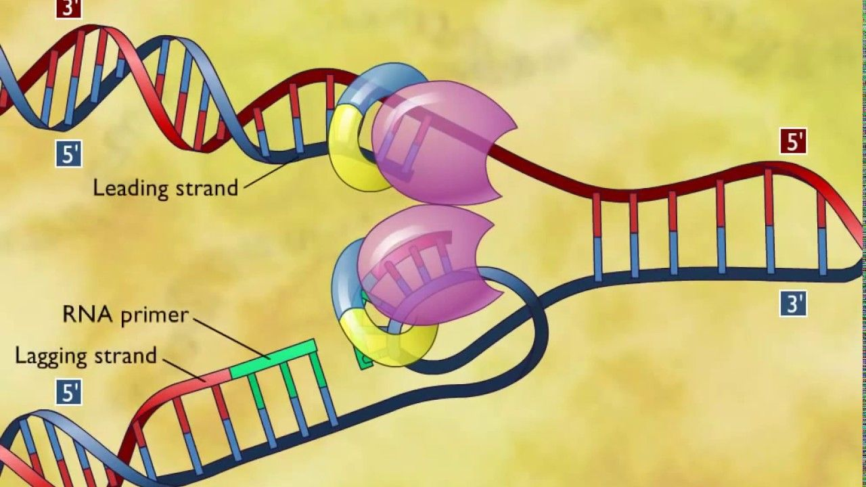
Image: King’s College London
3D replication / Stem DNA
AudioMoth
Image: Evelyn Piña Covarrubias

Slide 8
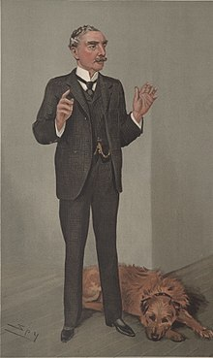

Slide 9
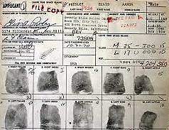

Slide 10
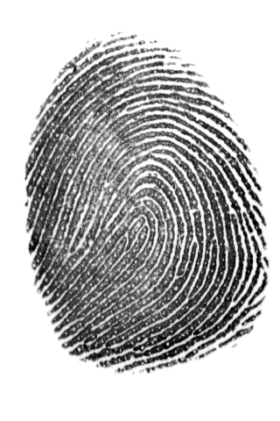
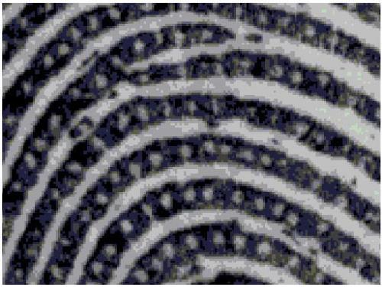

Slide 11
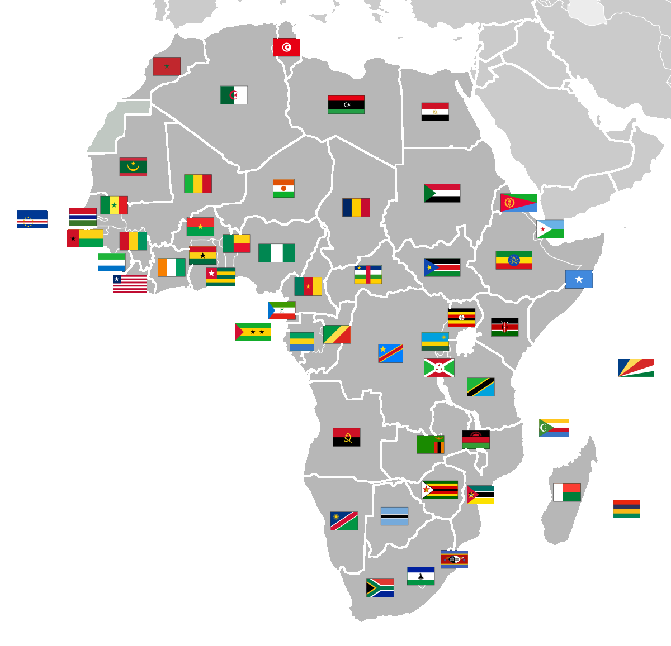
Notes:
The UK has the resources to assist and capability to introduce fingerprinting and forensics to nations that don’t

Slide 12
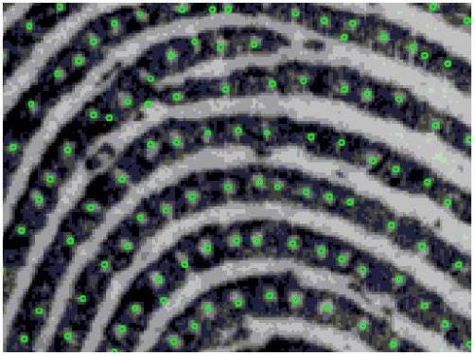

Slide 13
UK – DNA and fingerprint databases established.
Time: scene to identification

Slide 14
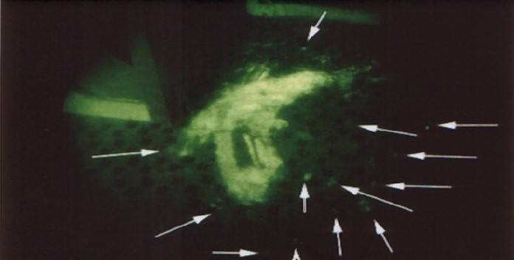
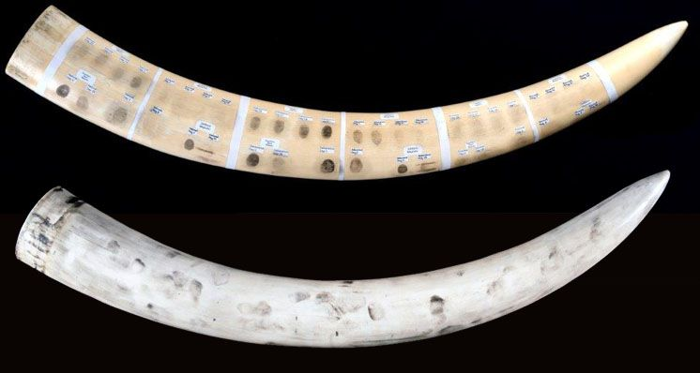
Research

Slide 15
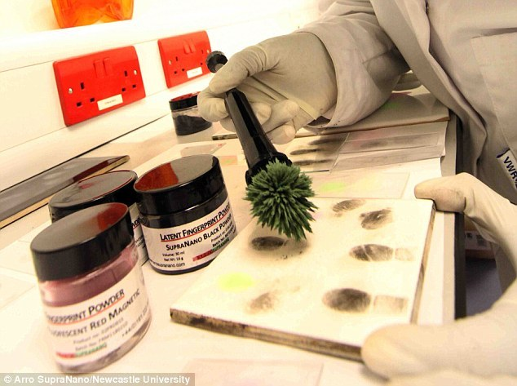
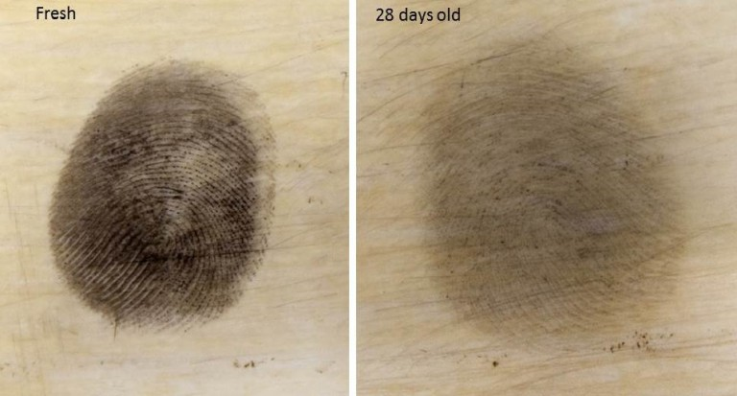
SupraNano powder

Slide 16
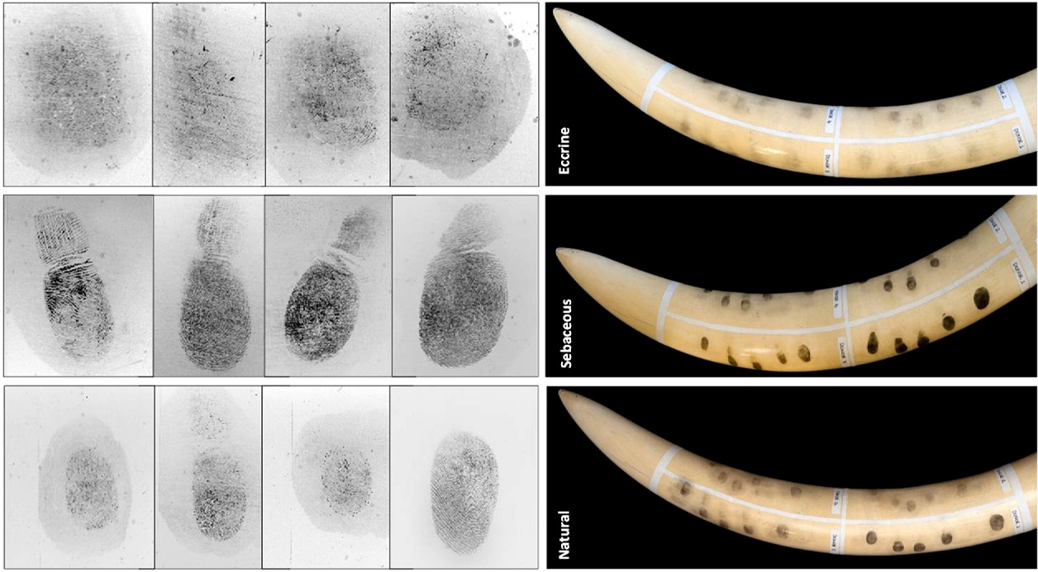
Eccrine
Sebaceous
Natural
Notes:
Images of enhanced fresh natural, sebaceous and eccrine marks on ivory using SupraNano Black Magnetic powder and examples of their corresponding tape lifts

Slide 17
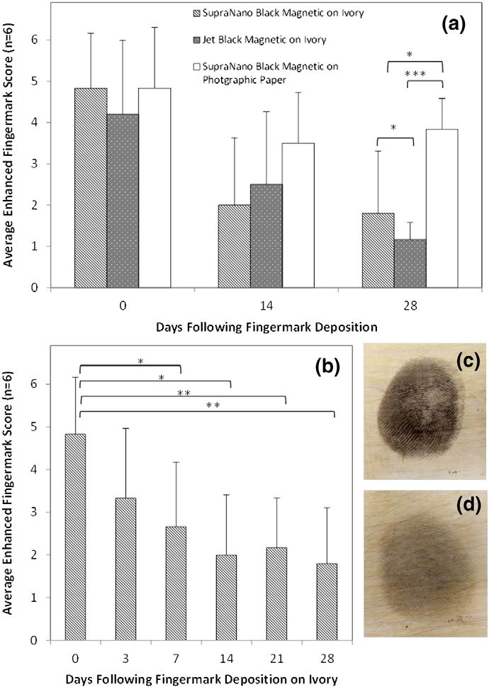
Effect of ﬁngermark age on enhanced ﬁngermark over 28 days
SupraNano Black Magnetic and Jet Black Magnetic over 0, 14 and 28 days on unpolished ivory and photographic paper
SupraNano Black Magnetic on ivory only at increased time interval frequency
Enhanced marks on ivory after 30 min and 28 days respectively
Notes:
Effect of ﬁngermark age on enhanced ﬁngermark over 28 days using (a) SupraNano Black Magnetic and Jet Black Magnetic over 0, 14 and 28 days on unpolished ivory and photographic paper and (b) SupraNano Black Magnetic on ivory only at increased time interval frequency. Insets (c) and (d) represent example enhanced marks on ivory after 30 min and 28 days respectively. Key: * = p ≤ 0.05; ** = p ≤ 0.01; *** = p ≤ 0.001. Bars represent the average grade obtained for n = 6 replicates (6 donors) and whiskers represent the standard deviation.

Slide 18
Image: Leon Barron
Image: Leon Barron
Image: King’s College London

Slide 19
Operational Response Database

Slide 20
Training
Crime Scene Management
Scenes of Crime / CSI
Intelligence and Evidence

Slide 21
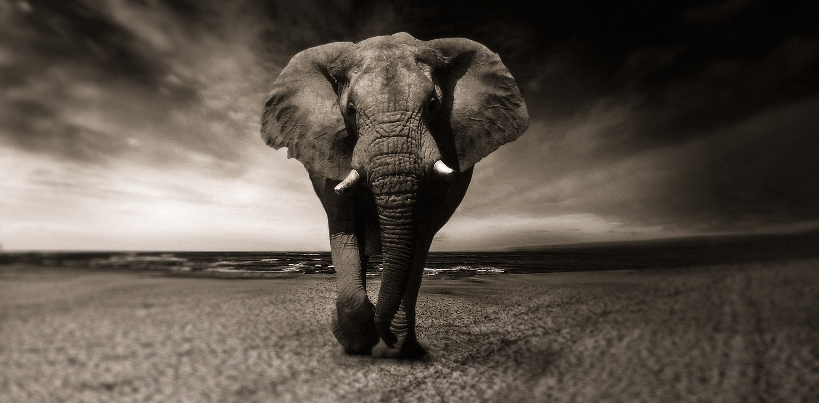
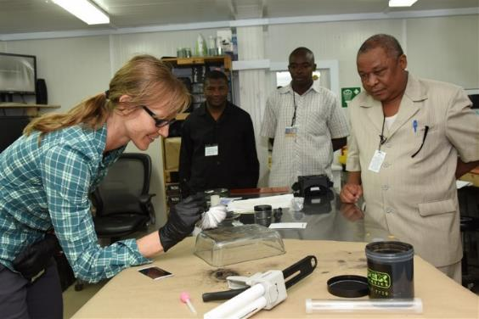
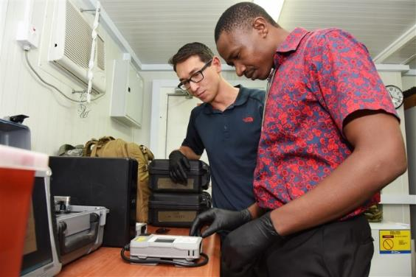
Where do we want to get to?
Sponsors
Partners
Notes:
Training of local enforcement officers and rangers in scene management and fingerprint recovery
What are the requirements for the transfer of fingermarks between sites? PNN available? In the UK we use the PNN (police national network) to transfer data securely - what could be used to bring in items from overseas. Technically should be fine providing there is secure internet.
Also what are the legal requirements to hold rangers/officers’ prints here? Have to work it park by park. Could Interpol act as a conduit? Obtaining local biometric data is actually what we’re needing to do and could really use interpols help to achieve.

Slide 22
African Parks have a partner for enabling effective intelligence capacity across their Park network
Zakouma, Chad
Pendjari, Benin
Liwoundi, Malawi
Garamba, Democratic Republic of Congo
Odzalla, Republic of Congo
Zimbabwe and Mozambique planned for 2019
Host Strategic Intelligence Database joining 20 parks
Notes:
More recently they have taken on another 2 Parks under separate NGO's in Malawi and Swaziland. Whilst they are a Private company they work very hard in keeping costs as low as possible and (anecdotally) told are more cost effective than many NGO’s.

Slide 23
In-country database options including remote digital recording
Continuity/Chain of custody… Intelligence or Evidence?
ISO and accreditation
Animal DNA
Toxicology
Crime scene to court – known and unknown scenes!
Impact assessments
Notes:
The UK has had a fingerprint database since 1901. A significant number of detections are still made using fingerprints.
Allows each bureau to search scene of crime marks and ten print sets. Ident1 is essentially a collection of databases against which you can search known and unknown marks and tenprint sets; Unknown tenprint sets can be searched against known tenprints within the database (to identify recidivists and deadsets). Unidentified marks from crime scenes can be searched against known tenprints within the database. Known tenprints can be searched against unidentified crime scene marks. Marks taken from one scene can be searched against crime scene marks on the database to link the scenes.
IDENT1 currently contains the fingerprints of 7.1 million people (according to National Police Improvement Agency). Verifies identity of some 1,500,000 people each year taken into custody and arrested or detained, as well as to link some 80,000 scenes of crime marks each year to previously proven identities. Checks more than 2,000 identities from Lantern mobile devices per month. The current turn-around time for simple mark to print searches can be 60 seconds. For multiple searches/prints this can take a few minutes.
Connects 57 police forces and agencies, with over 1200 workstations and 440 Livescan units throughout UK.
IDENT1 also has an interface to the Immigration and Nationality Directorate's (IND) Immigration and Asylum Fingerprint System (IAFS). Searches can be conducted in both directions by the IND and the police service.Checks 40,000 identities per week for UK Visas and Immigration.

Slide 24
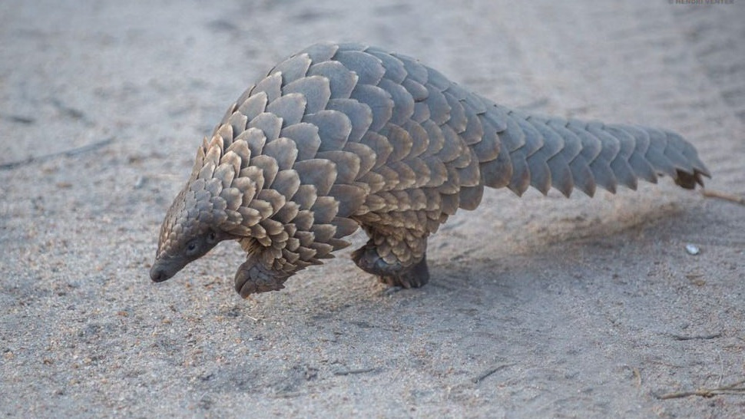

Slide 25
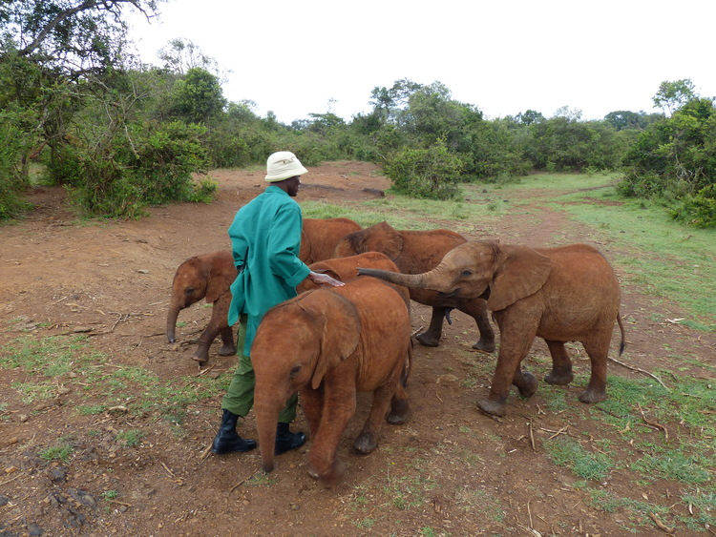
Thank you

