Slide 1


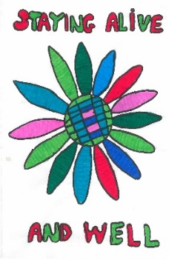




2022
LeDeR
Learning from lives and deaths:
People with a learning disability
and autistic people
Made with PhotoSymbols™

Slide 2


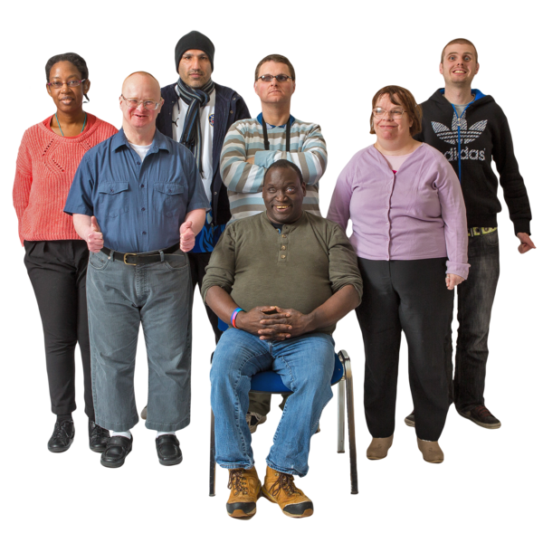
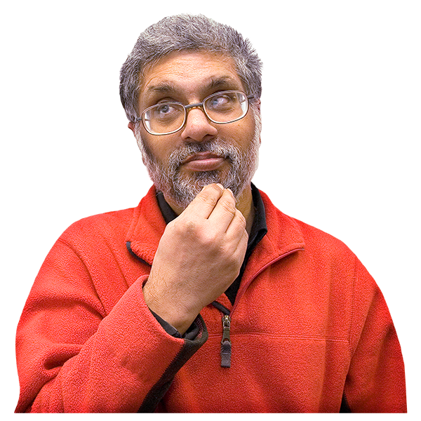
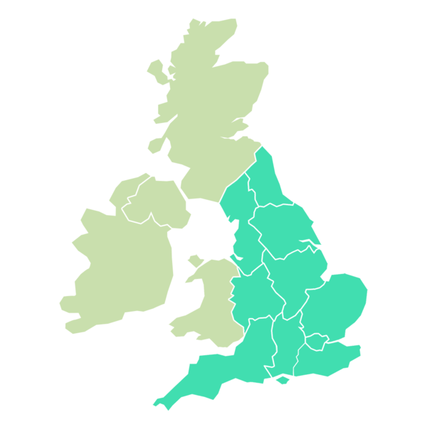
What can we say about the people with a learning disability who died in England in 2022?

Slide 3
This video has 7 parts.
Each part has a different colour.
1
2
3
4
5
6
7

Slide 4
This is what is in each part…
1
2
3
4
5
6
7

Slide 5



The grey part:
Who died, and how old were they?
?

Slide 6

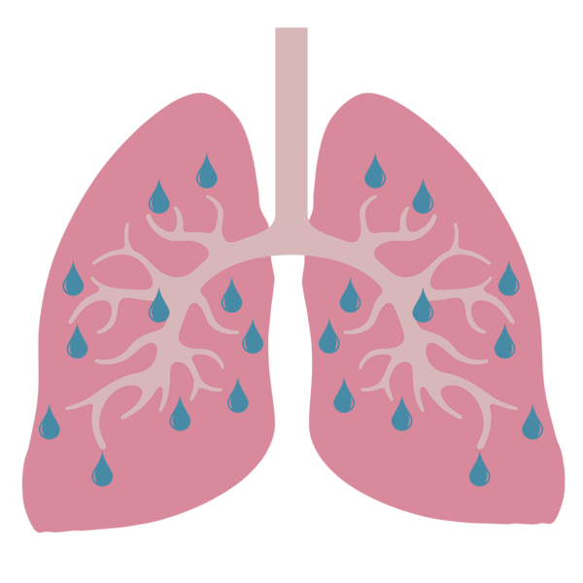


The yellow part
What did people with a learning disability die of in 2022?
?

Slide 7
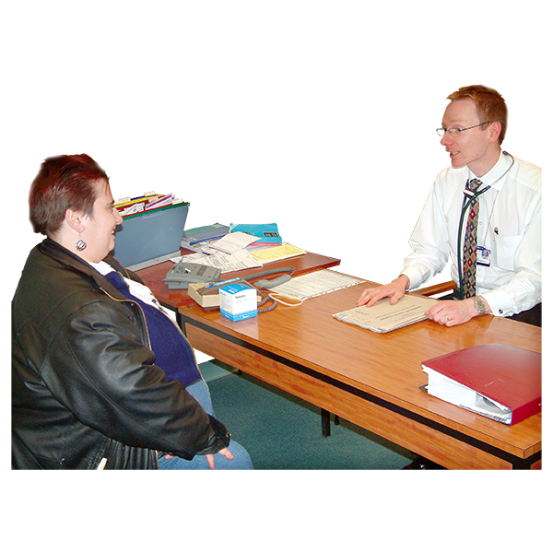




The blue part:
How good was the care for the people with a learning disability who died?

Slide 8

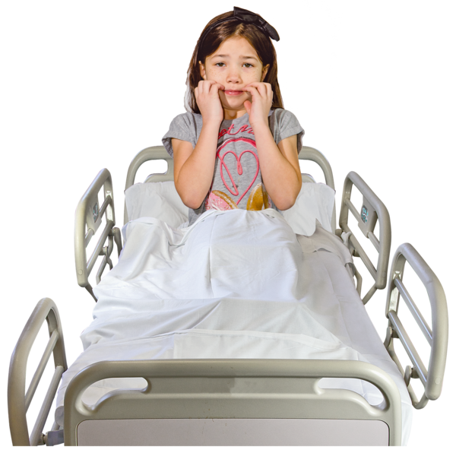
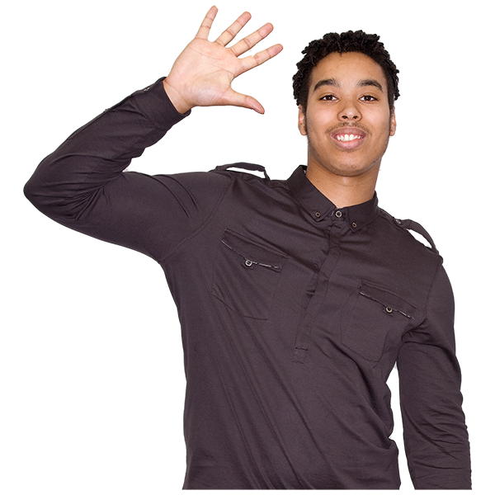
The green part:
Which people with a learning disability were more likely to die younger?

Slide 9




The orange part:
Could more people with a learning disability have lived longer?

Slide 10
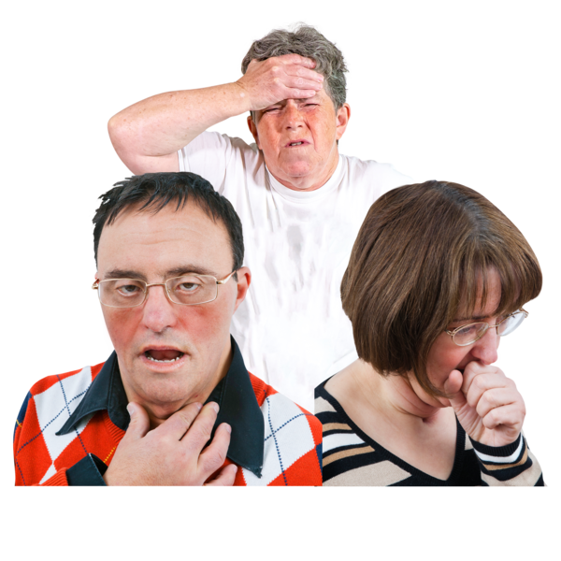
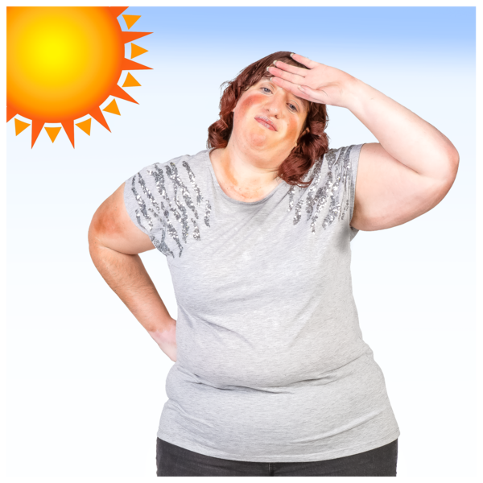
The pink part:
COVID-19 and heatwaves

Slide 11
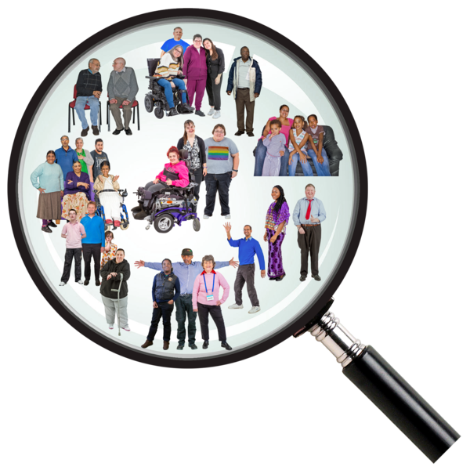
The purple part:
Autistic people who don’t have a learning disability

Slide 12
Now we are going to look at each part.
1
2
3
4
5
6
7

Slide 13

The grey part
Who died in 2022, and how old were they?
?

Slide 14
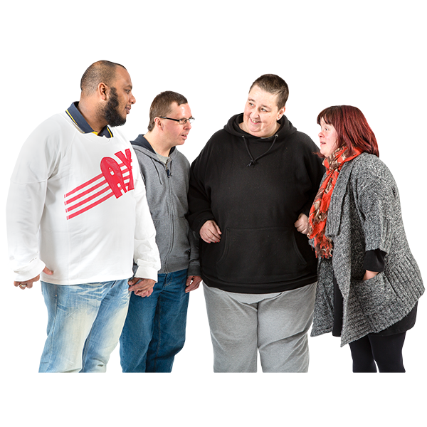
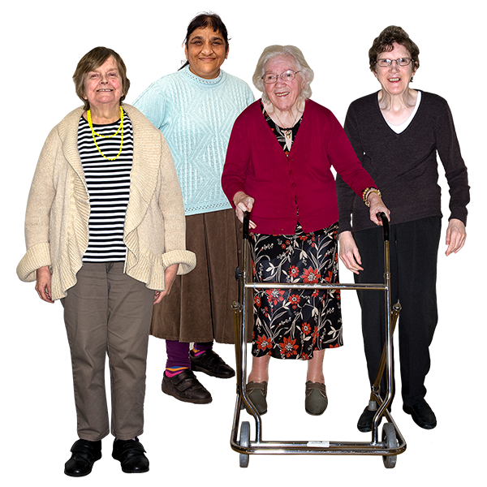
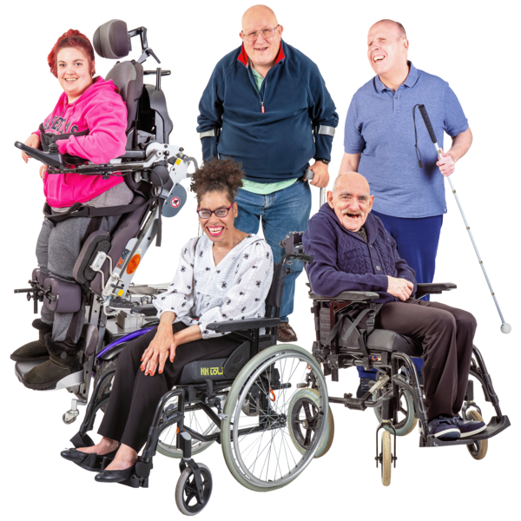
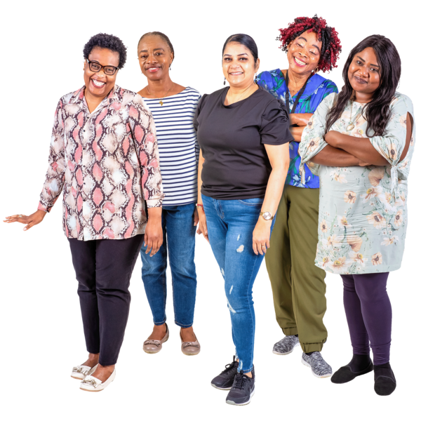
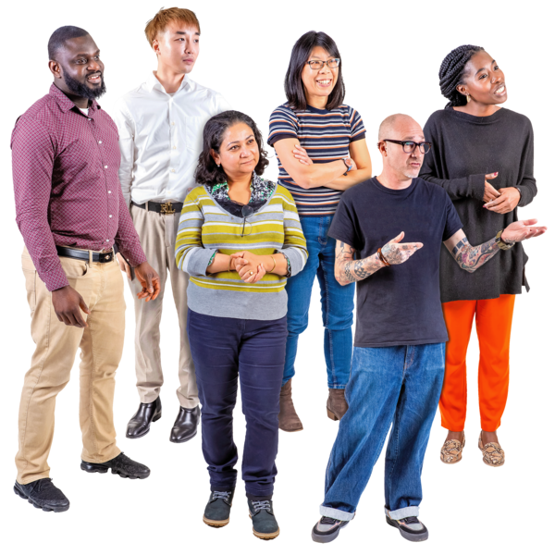
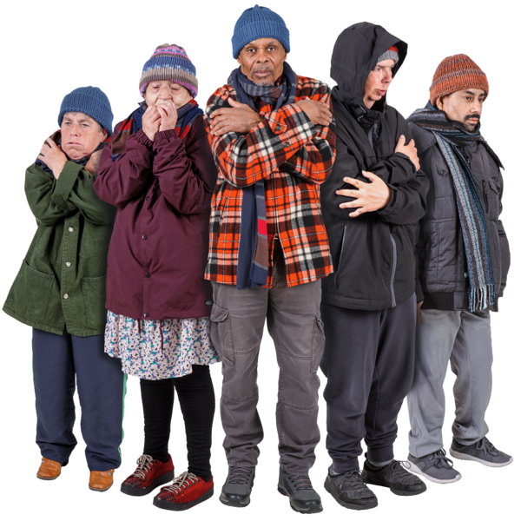
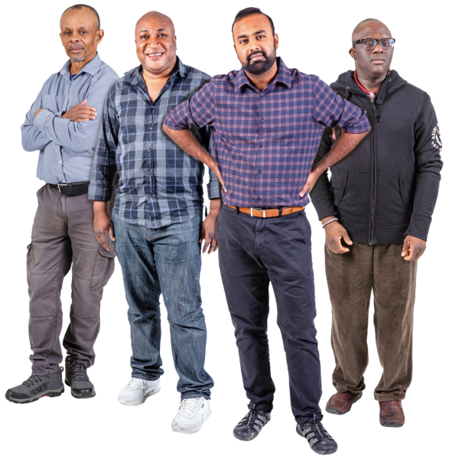
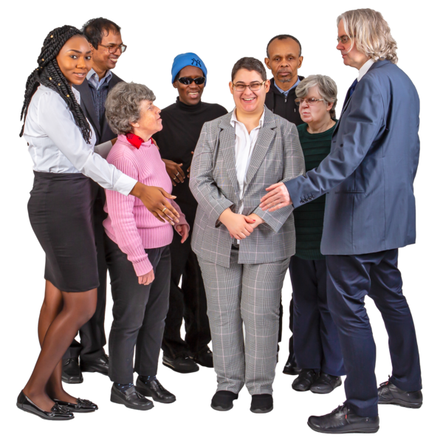
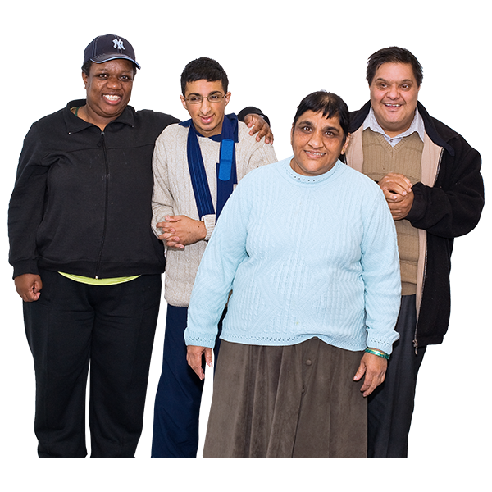
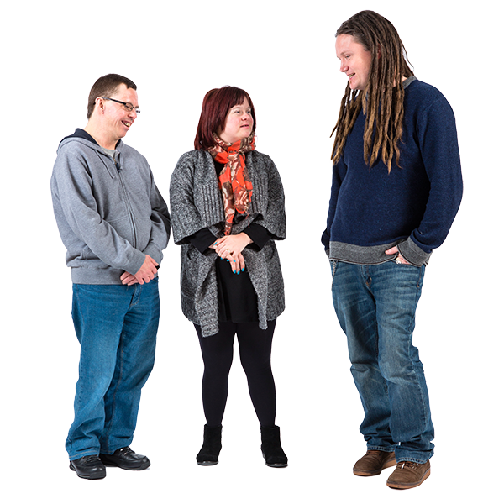
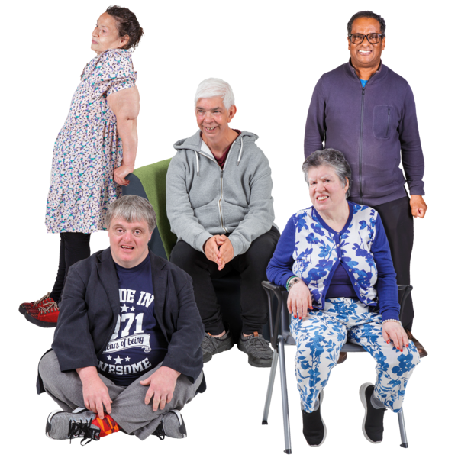
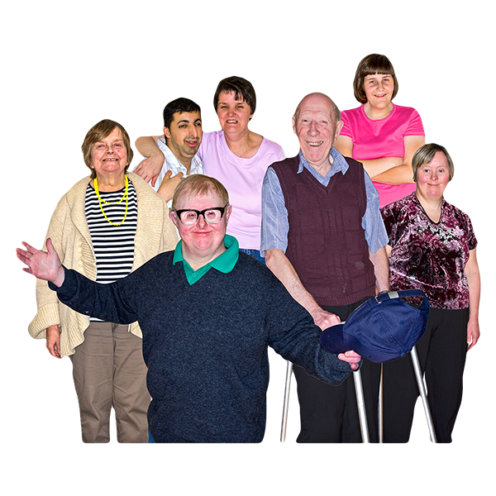
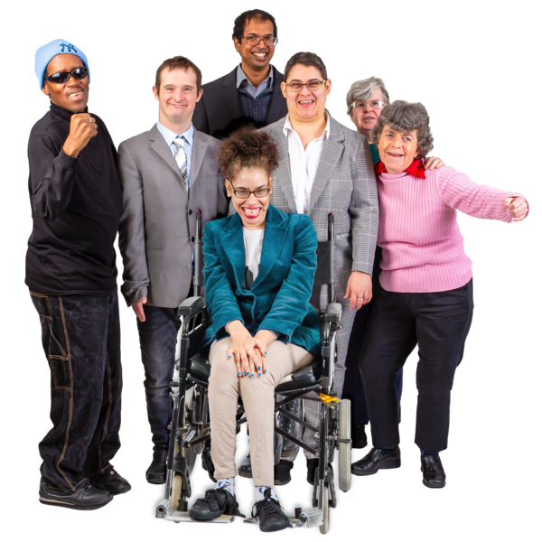
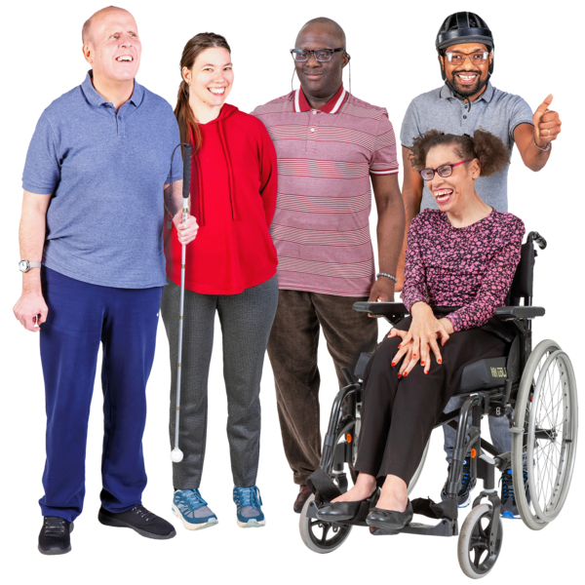
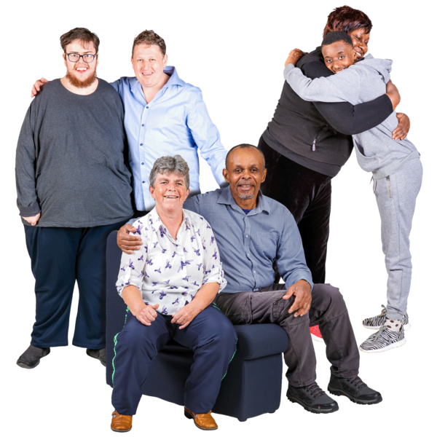
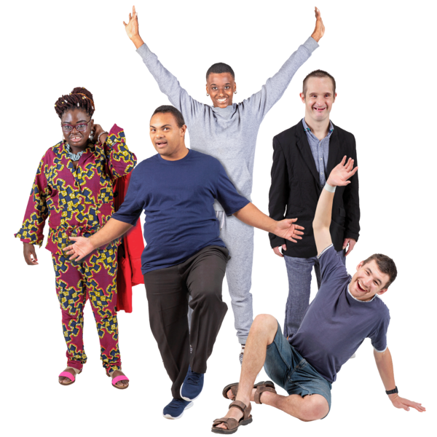
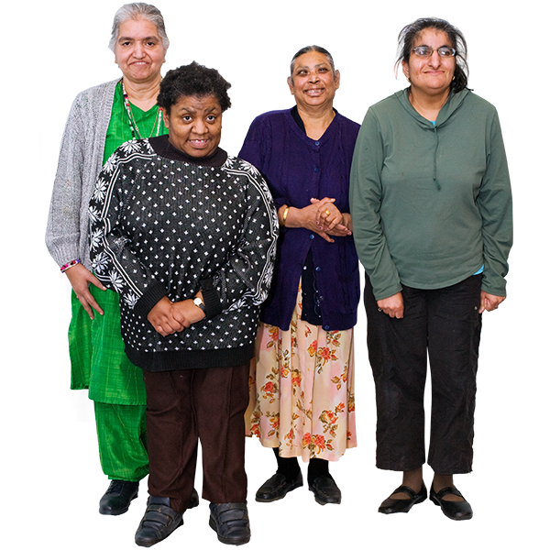
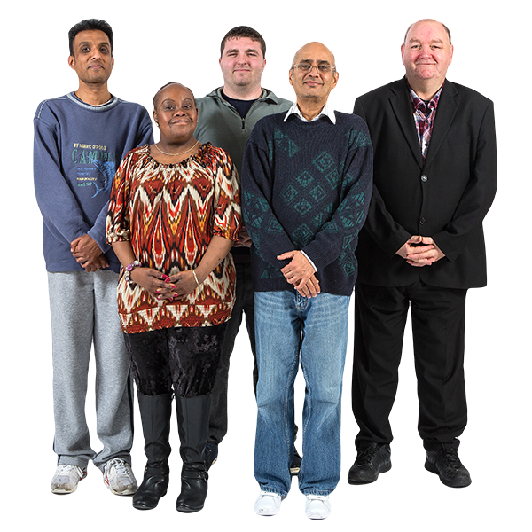
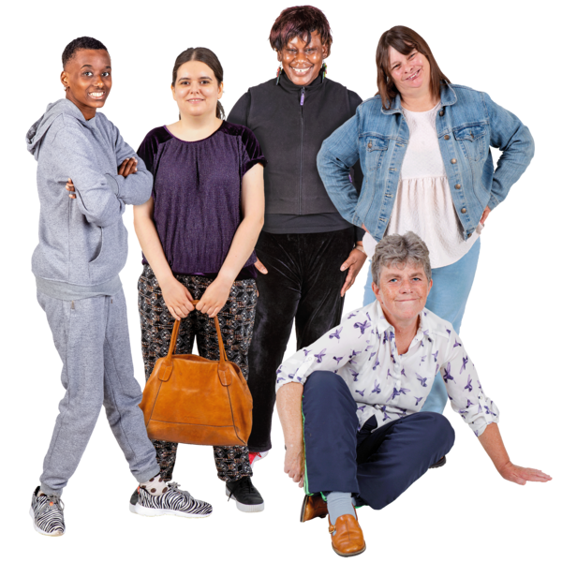
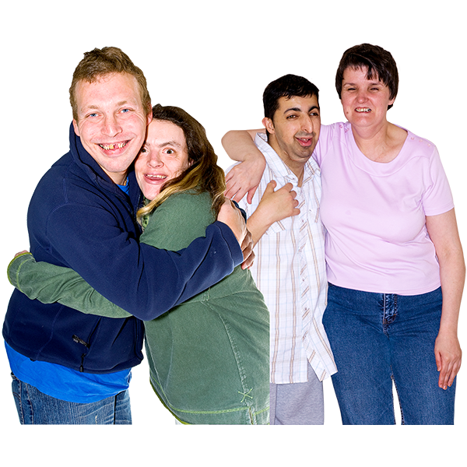
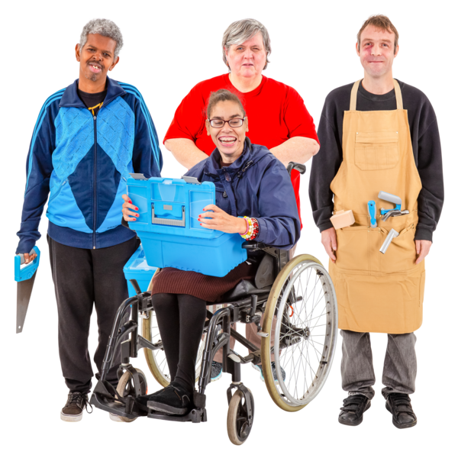
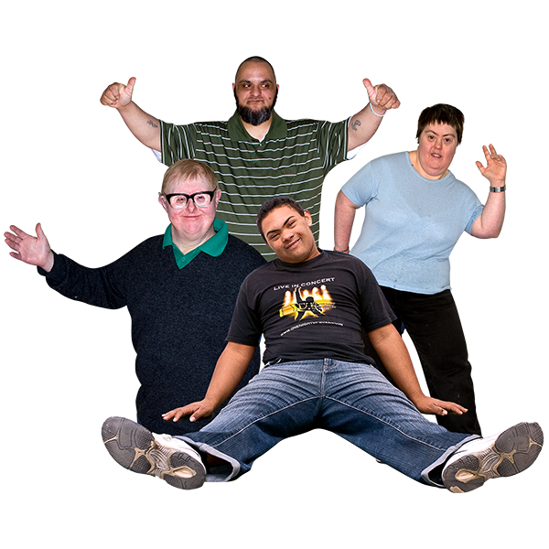
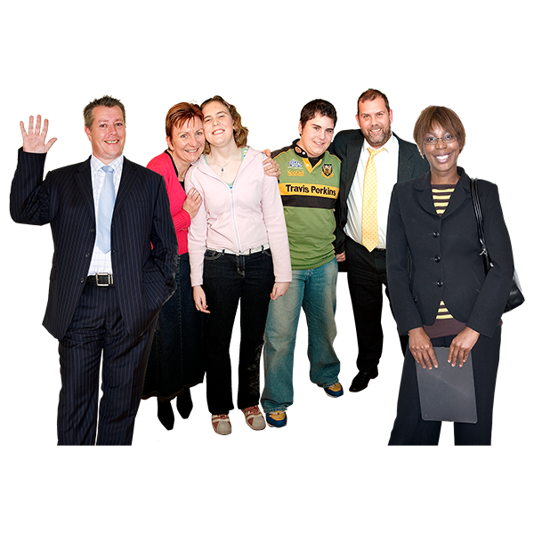
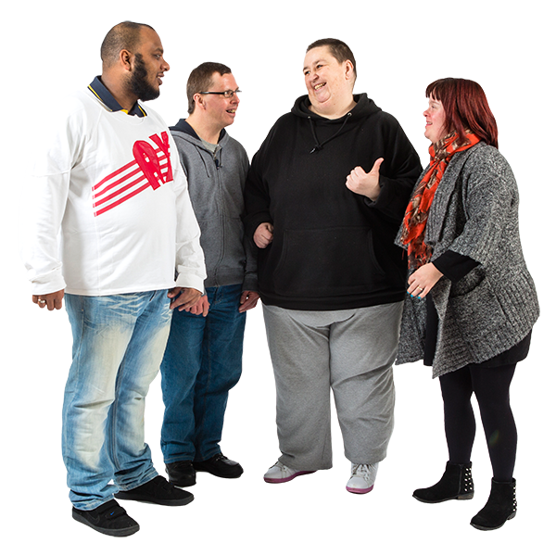
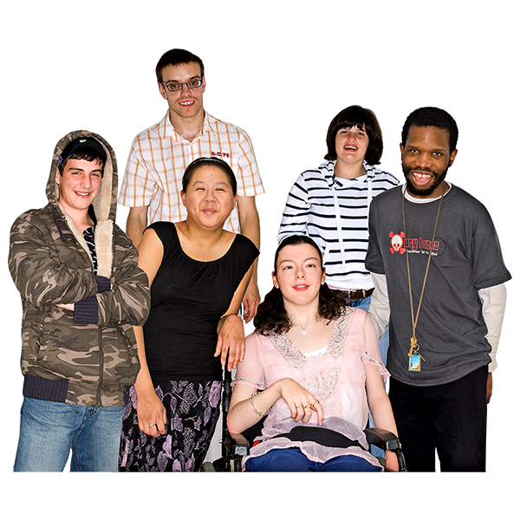
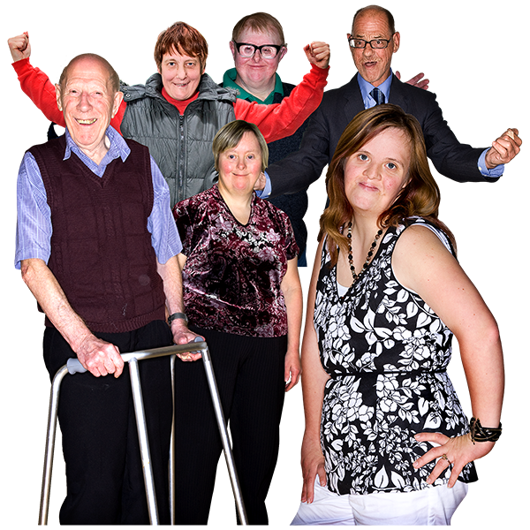
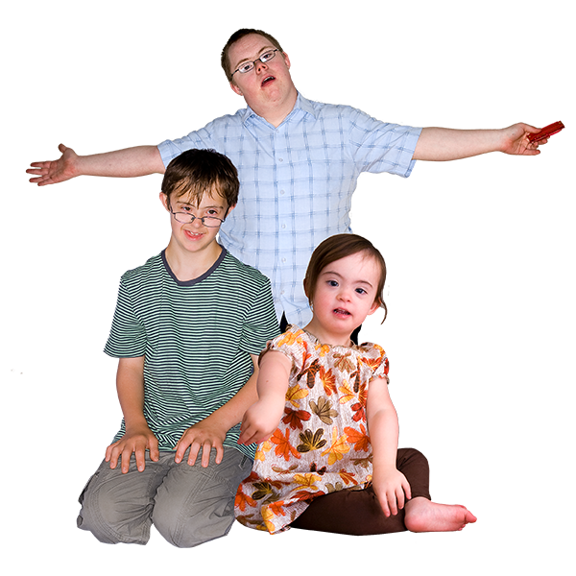
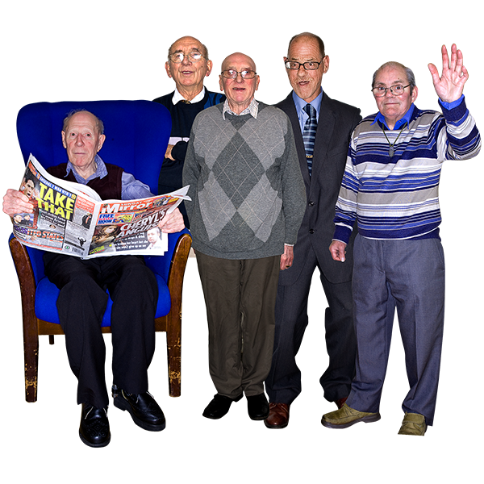
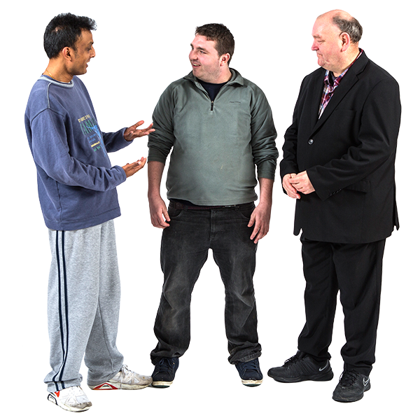
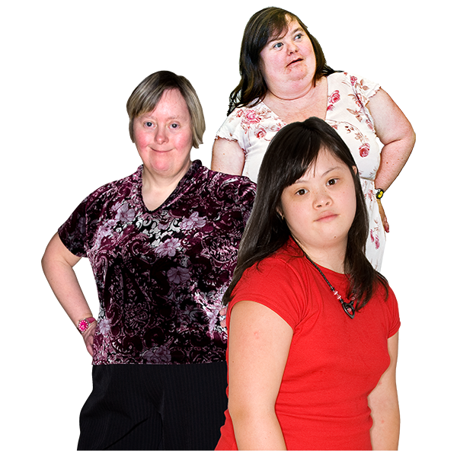
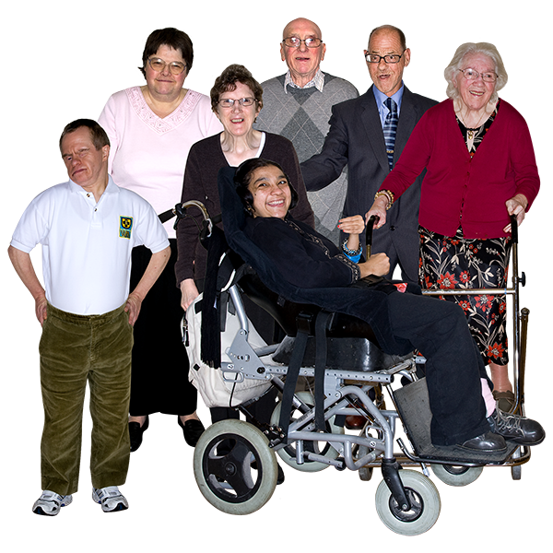
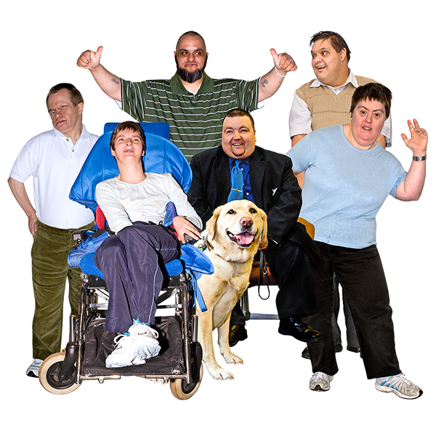
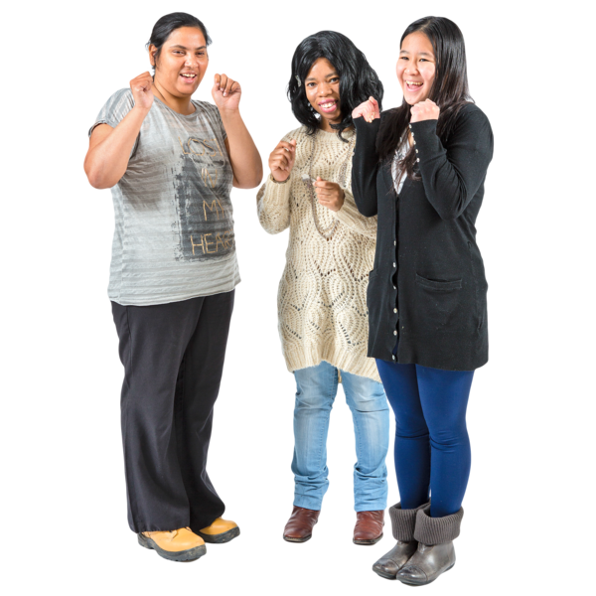
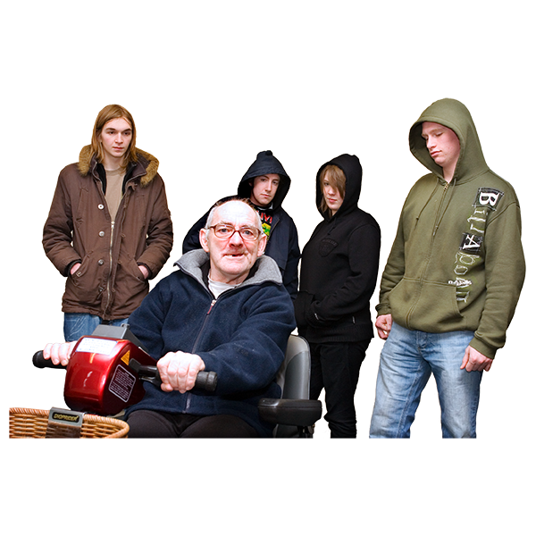
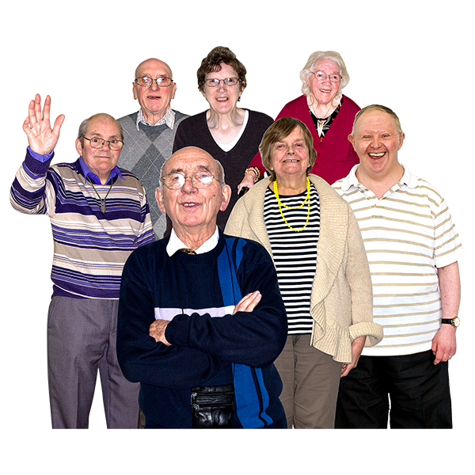
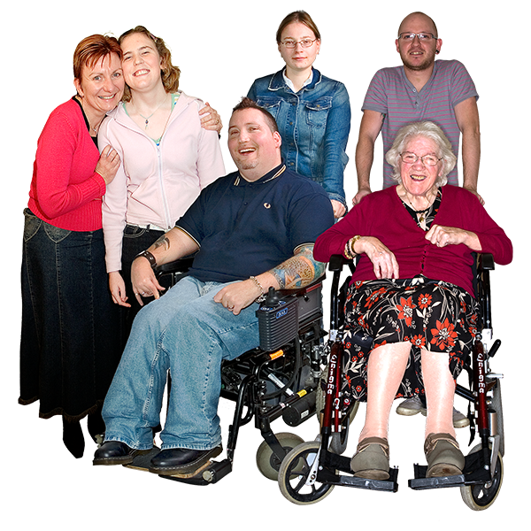
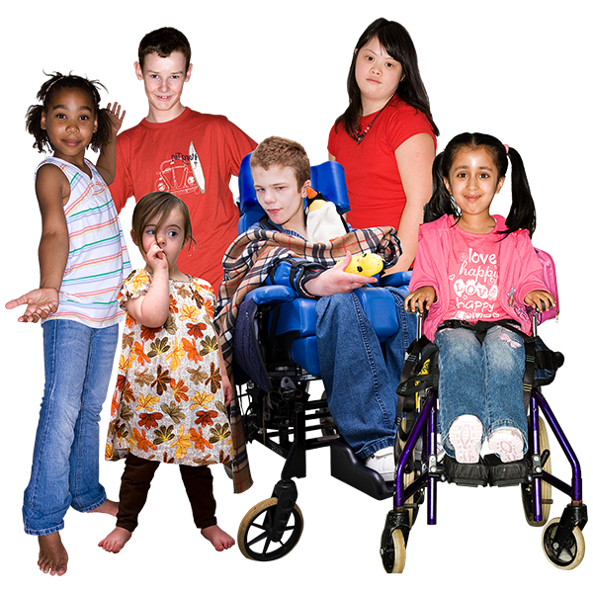
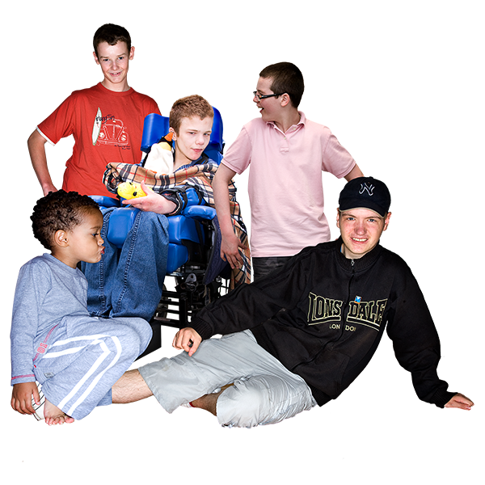
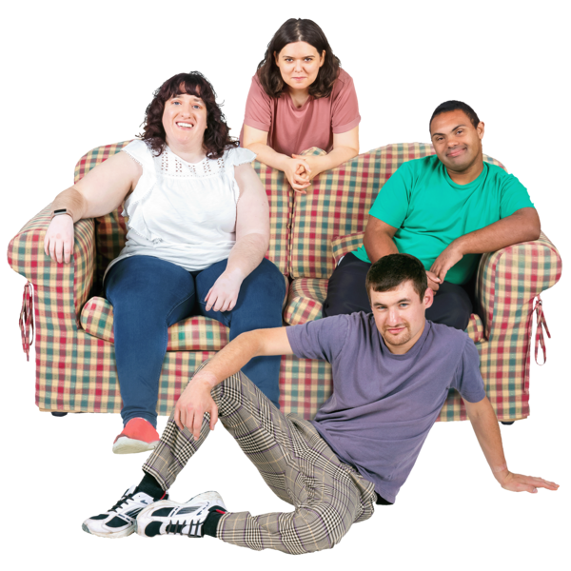

We heard about 3,648 people with a learning disability who died in 2022
3,648
people

Slide 15


Of each
10 people with a learning disability who died…
6 were men
4 were women

Slide 16
Of each
10 people with a learning disability

Slide 17





4 were still alive at the age of 65

Slide 18
Of each 10 people who don’t have a learning disability,
9 were still alive at the age of 65

Slide 19


It means that people
who have a learning disability
don’t live as long as people who don’t have a learning disability
Notes:
Old people without a LD
A few old people with a LD and empty chairs / wheelchairs.

Slide 20









Men with a learning disability usually died
20 years earlier

Slide 21
Women with a learning disability usually died 23 years earlier
Notes:
Do not say “with a learning disability”

Slide 22





Of each
10 people with a learning disability
who died…
6 died in hospital
1 died
somewhere else
3 died
at their home

Slide 23










Most people we heard about, who died, were white.

Slide 24










We need to learn more about the people from minority ethnic backgrounds who died.
Black people
Asian people
People from mixed backgrounds
Other people who are not white.

Slide 25
The yellow part
What did people with a learning disability die of in 2022?
?

Slide 26

Of each
100 people with a learning disability who died in 2022…
Notes:
Babies 13
Cancer 11
Cerebral 6
Ischaemic 6
COVID 6

Slide 27
13 died of health problems that they have had all their lives, from when they were babies

Slide 28

11 died of cancer
cancer

Slide 29
8 died of flu and lung infections (pneumonia)

Slide 30

6 died of cerebral palsy and paralysis

Slide 31
6 died of heart problems

Slide 32
6 died of COVID-19

Slide 34
The others died of all sorts of other things

Slide 35
The blue part
How good was the care for the people with a learning disability who died?

Slide 36
Most people with a learning disability
(9 out of 10) had some care which was good.
This doesn’t mean that all their care was good, but at least some of it was good.

Slide 37
But some people
(1 out of 10)
did not have any good care.

Slide 38

We spot a difference here!

Slide 39
Last year 3 out of 10 people did not have any good care

Slide 40
This year it is 1 out of 10

Slide 41
This year it is 1 out of 10
But it is still 1 too many

Slide 42
What was good about people’s care?

Slide 43

Reasonable adjustments helped people get good care

Slide 44



Changes staff can make to help people cope with their care and treatment.
For example:
What are reasonable adjustments?
Easy-to-understand information
More time
A calm place to wait

Slide 45


Staff working together and working with families helped people get good care
Notes:
And working with families pictures appear

Slide 46
What problems were there about people’s care?

Slide 47


People were waiting too long to get tests and treatments

Slide 48


Doctors and nurses were not doing mental capacity assessments properly

Slide 49
What is a Mental Capacity Assessment?
A Mental Capacity Assessment is when they check to see what you understand.

Slide 50
What is a Mental Capacity Assessment?
It is to see if you
can help make decisions about your own
care and treatment.

Slide 51
The green part
Which people with a learning disability were more likely to die younger?

Slide 52

People who didn’t get good care and treatment

Slide 53
People who didn’t get good care and treatment
For example: They didn’t get a COVID vaccine

Slide 54
People who didn’t get good care and treatment
For example, they didn’t get a COVID vaccine
They were more likely to die younger

Slide 55
People from minority ethnic backgrounds were more likely to die younger.
This means that many white people with a learning disability lived longer than people that were black, Asian or mixed backgrounds.

Slide 56


People with epilepsy were more likely to die younger.

Slide 57
The orange part
Could more people with a learning disability have lived longer?

Slide 58

Some people died before their time.

Slide 59

Perhaps they could have lived longer if they had got better treatment and support.

Slide 60


For example, by:
Treating an infection
Managing epilepsy well

Slide 61

Or perhaps they needn’t have got ill in the first place.

Slide 62

For example, by:
Getting a vaccine
Checking for illnesses

Slide 63


This is called avoidable death.
It means: dying of something that nowadays, you shouldn’t have died of.

Slide 64
Almost half of all the people with a learning disability who died, died an avoidable death.

Slide 65
But of all the people without a learning disability who died, less than a quarter died an avoidable death.

Slide 66
This means that people with a learning disability are twice as likely to die before their time.

Slide 67
The pink part:
COVID-19 and heatwaves

Slide 68
This is a spot the difference chapter
because it is different from last year

Slide 69
COVID-19

Slide 70

In 2021, lots of people died of COVID

Slide 71
In 2022, fewer people with a learning disability died of COVID

Slide 72





But people with a learning disability are still more likely to die of COVID than people without a learning disability

Slide 73

So, we still need to be at the top of the list for vaccines

Slide 74
Heatwaves

Slide 75


Lots of extra people with a learning disability died in July
2022

Slide 76
Lots of extra people with a learning disability died in July
2022
We think this was because of a heatwave

Slide 77



This means people with a learning disability need extra protection from the heat

Slide 78
The purple part:
Autistic people who don’t have a learning disability

Slide 79


This is Gary
Gary died in 2022

Slide 80
This is Gary
Gary is autistic

Slide 81
This is Gary
Gary
does not have
a learning disability

Slide 82





This is Gary
LeDeR
Report a Death
Gary’s death can now be reported to LeDeR
Gary (1958-2022)

Slide 83
This is Gary
Gary’s death can now be reported to LeDeR
LeDeR
Report a Death
Gary (1958-2022)
even though Gary does not have a learning disability

Slide 84

This is new

Slide 85
All autistic people can now be reported to LeDeR

Slide 86
All autistic people can now be reported to LeDeR
even if they don’t have a learning disability

Slide 87
In 2022 we heard about
110 autistic people who didn’t have a learning disability
110

Slide 88
Most autistic people without a learning disability who died in 2022 were not reported to LeDeR
?

Slide 89
We need to know more about their deaths so we can learn from it
?

Slide 90


This video was produced by
the Staying Alive and Well Group.
We are a group of people who have a learning disability or who are autistic, meeting at Kingston University London:
Richard Keagan-Bull, Maggie Brennan, Amanda Cresswell, Frankie Cutri, Joanne Kennedy, Andrew Meyer, Lee Scott, Mark Shackleton, Sonia Reed, Wayne McGregor, Caroline Ogundeji, Sunny Sokhal.
We were supported by:
Irene Tuffrey-Wijne, Jonathon Ding and Natasha Marsland (Kingston University), Janice Wycherly and Dene Donalds (Pathways Associates), David Mahon (Foundation for People with Learning Disabilities), Ruwani Ampegama (Estia Centre) and Jeanette Gallivan-Young (Learning Disability Partnership Board - East Sussex).
The Staying Alive and Well group is a co-production partnership. They are part of a collaboration led by King’s College London, supporting the NHS England. Gary is not a real person. He was made up to help explain the purple part.

Slide 91
This is a video introduction to the full 2022 Annual Report for LeDeR: Learning from Lives and Deaths – People with a Learning Disability and Autistic People.
The following versions of this report are freely available here: www.kcl.ac.uk/research/leder
The full 2022 Annual Report
An easy-read video version
An easy-read pdf version
This video can be freely used, but must remain unaltered.

